Slide 1
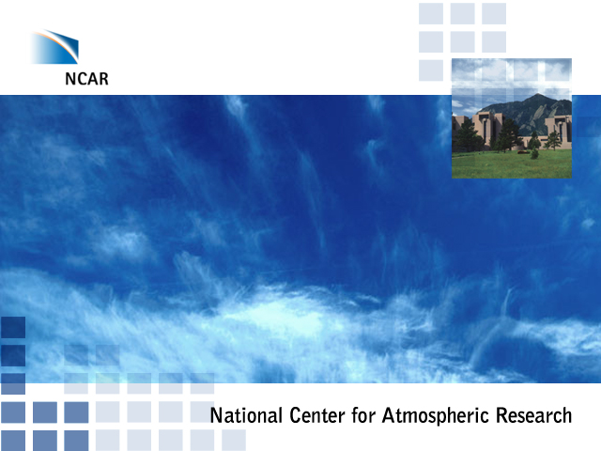
Development of Flood Forecasting for the Ganges and the Brahmaputra Basins using satellite based precipitation, ensemble weather forecasts, and remotely-sensed river widths and height
Tom Hopson, NCAR (among others)
Charon Birkett, Univ. of Maryland
Robert Brakenridge, Dartmouth Flood Observatory

Slide 2
Goals
Objective 1
Assess the skill and estimate the errors in some of the foundational data sets available for use in flood forecasting for India, focusing on remotely-sensed products useful for catchments with limited on-the-ground monitoring
Objective 2
Integrating these data sets into a common hydrologic forecasting framework, showing how this can be achieved from an “engineering perspective”, but also provide operational forecasts with potential for societal benefit
Objective 3
Provide effective displays for these products, including maps of areas of inundation corresponding to forecasted discharge that have potential benefits for “on the ground” operations and decision-making
Objective 4
Utilizing estimates of the errors in the hydrologic forecasting framework and input data sets, determine the overall predictability of the system to forecast flooding events of differing levels of severity in the Ganges and Brahmaputra watersheds at different locations and forecast lead-times; from this assessment, recommendations can be made on where investments should be focused to increase flood forecasting capacity throughout the basins to meet World Bank development goals
Notes:
More goals:
-- improve flood forecasting for India and the region, capitalizing on new remotely-sensed products that can transcend the need for national and in-situ provided data
-- merge together independent data sets and technologies developed to use them, under one framework
-- provide probabilistic (ensemble) forecasts such that the user can have information on the certainty of the forecasts themselves
Understand points of weakness and strength & limits of predictability, such that the World Bank (and other supporters) can best be informed on how to focus limited resources.

Slide 3
Outline
Sources of predictability
Satellite-derived precipitation
Satellite-derived river flows
  River widths
  River heights
Ensemble weather forecasts
Modeling structures
Communication: displays
Conclusions

Slide 4
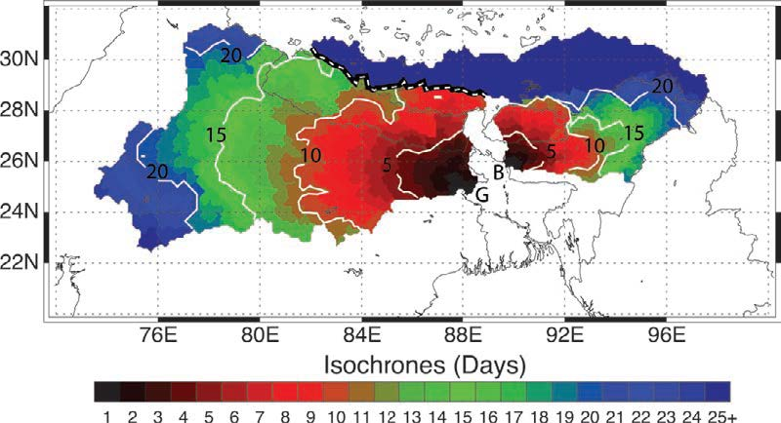
Isochrones
Notes:
Isochrones (days) for the Brahmaputra and Ganges basins. The contours provide an estimate of the time it takes for water in a particular location in the basin to pass from the headwaters to the outflow points into Bangladesh (“G” for the Ganges, and “B” for the Brahmaputra). Isochrones were constructed using a flow routing algorithm and digital elevation data (details in text). The separation of the two basins is shown as a thick dashed white lines. Isochrones for 5, 10, 15 and 20 days are shown as solid white lines. POINT: the important concept is that upstream observations (whether of rainfall or river discharge) inherently can provide information on future river flows that will occur lower down in the catchment up to the time of concentration time-scale.

Slide 6
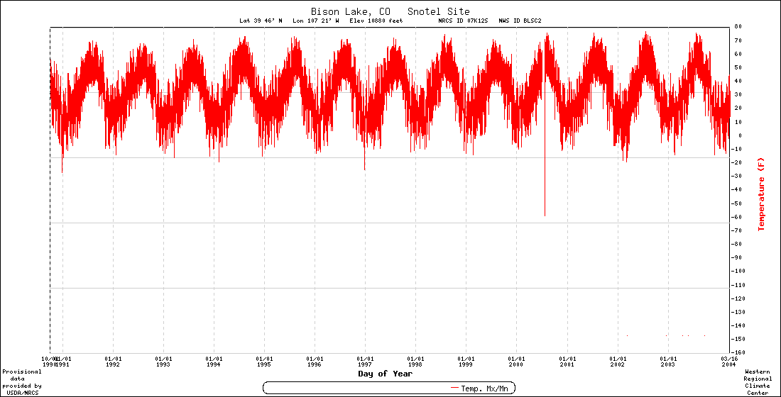
Sources of Predictability
Model solutions to the streamflow forecasting problem…
Observed Data
SNOW-17 / SAC
Historical Simulation
Precipitation
Soil moisture
River flow
Past
Future
Run hydrologic model up to the start of the forecast period to estimate basin initial conditions; the flows created can then be “advected” downstream

Slide 7
Sources of Predictability
Model solutions to the streamflow forecasting problem…
Historical Data
Forecasts
SNOW-17 / SAC
Historical Simulation
?
Precipitation
Soil moisture
River flow
Past
Future
Run hydrologic model up to the start of the forecast period to estimate basin initial conditions;
Run hydrologic model into the future, using an ensemble of local-scale weather and climate forecasts.
Notes:
Now we consider what happens when we used forecasts of rainfall, instead of just observed -- requires running the hydrologic model into the future using ensemble (i.e. probabilistic) weather forecast data.

Slide 8
Sources of Predictability
Model solutions to the streamflow forecasting problem…
Historical Data
Forecasts
SNOW-17 / SAC
Historical Simulation
Precipitation
Soil moisture
River flow
Past
Future
Run hydrologic model up to the start of the forecast period to estimate basin initial conditions;
Run hydrologic model into the future, using an ensemble of local-scale weather and climate forecasts.
Notes:
Now we consider what happens when we used forecasts of rainfall, instead of just observed -- requires running the hydrologic model into the future using ensemble (i.e. probabilistic) weather forecast data.

Slide 9
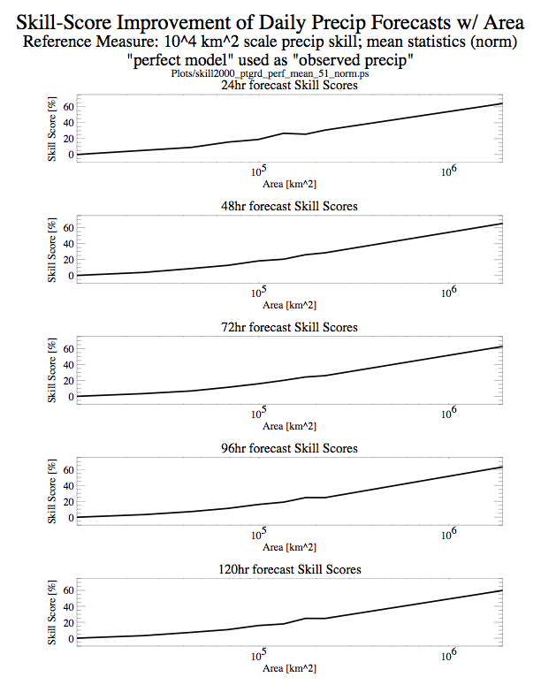
Rule of Thumb:
-- Weather forecast skill (RMS error) increases with spatial (and temporal) scale
=> Utility of weather forecasts in flood forecasting increases for larger catchments
-- Logarithmic increase

Slide 10
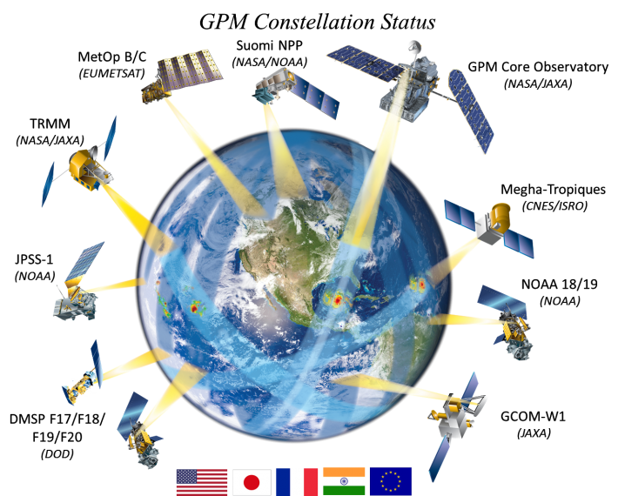
Notes:
Observed precipitation: New constellation of precipitation-measuring satellites have gone up that were utilizing in this project. These replace the previously successful TRMM precipitation measurement instruments. Joint venture of NASA/JAXA/CNES/ISRO/EU --- note India’s involvement.

Slide 11
_{IMERG}
(Integrated Multi-satellitE Retrievals for GPM)
Long term vision:
IMERG is “intended to intercalibrate, merge, and interpolate “all” satellite microwave precipitation estimates, together with microwave-calibrated infrared (IR) satellite estimates and precipitation gauge analyses.”
http://pmm.nasa.gov/sites/default/files/document_files/IMERG_ATBD_V4.4.pdf
Coverage:
  Global
  Currently available back to March 15, 2014
  Eventually will extend back to 1998 (not finalized until 2017?)
Resolution:
  0.1 degree
  30 minute
Real time and calibrated products:
  “Early”: 4hrs past observation time
  “Late”: 12 hrs past observation time
  “Final”: 4 months (later, 2 months) after observation time, calibrated to gauge data
Algorithms:
  CMORPH-KF Lagrangian Time interpolation scheme
  PERSIANN-CCS recalibration scheme

Slide 12
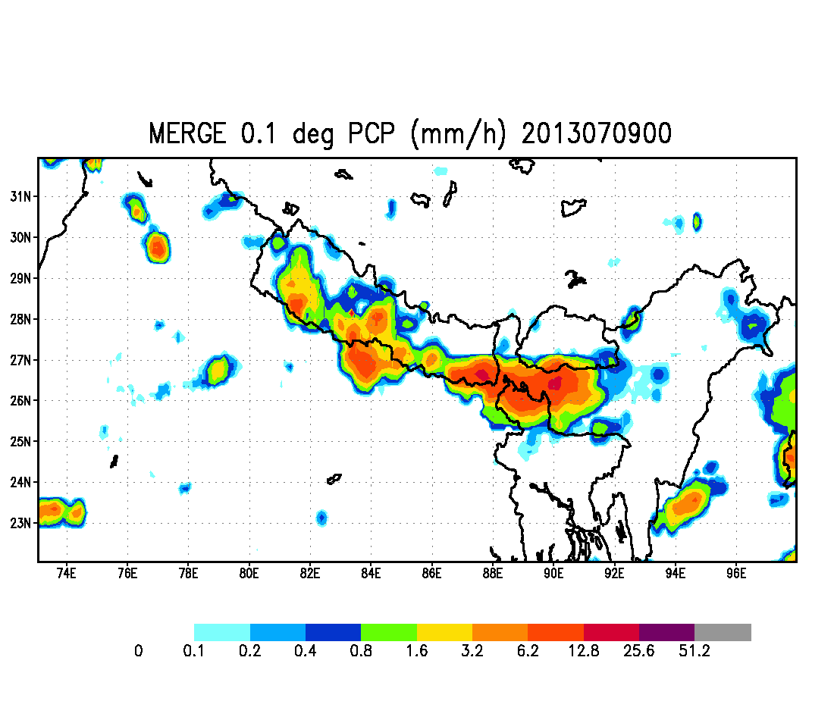

Notes:
Movie of one day’s “merged” rainfall we are using for this project – blended precipitation estimates from NOAA CMORPH, NASA 3B4RT, and JAXA to reduce overall error. If the individual products were compared, there are clear differences in locations and intensities of rainfall at finer scales, although the general large-scale features are generally in common.

Slide 13
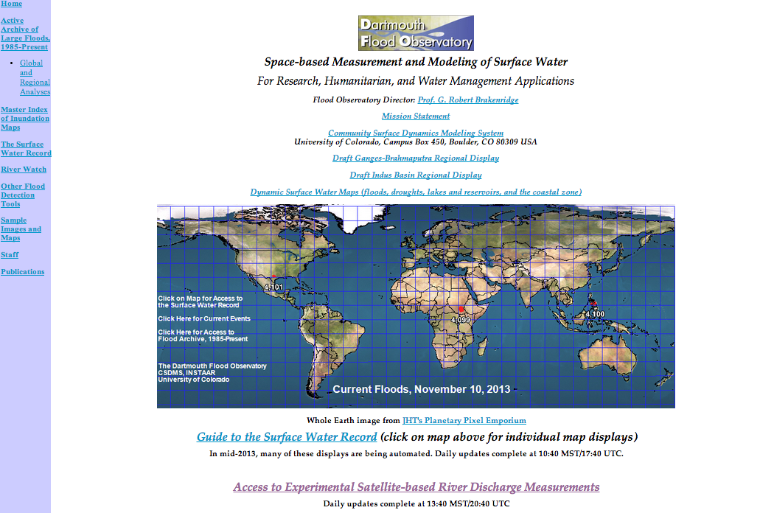
Data and data services to be discussed are available at the Flood Observatory
http://floodobservatory.colorado.edu/

Slide 14
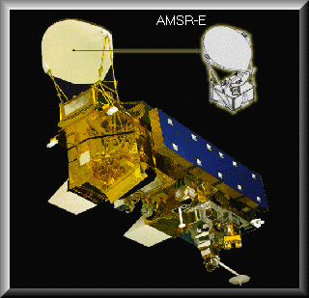
Objective Monitoring of River Stage and Flow:
Satellite-based Passive Microwave Radiometer
-- Advanced Microwave Scanning Radiometer - Earth Observing System (AMSR-E) & NASA TRMM
(Future: Global Precipitation Measurement System)
- Utilizing 36-37Ghz (unaffected by cloud)
- pixel size ~20km
- ~2day complete global coverage (night-time brightness temperatures)
- data range: 1997 to present
Other Approaches: satellite altimeter-derived water level (and discharge derived through rating curve):
e.g. Birkett, 1998; Alsdorf et al. 2000; Jung et al. 2010, Papa et al. 2010, Alsdorf et al. 2011, Biancamaria et al. 2011
Notes:
Here is one of the satellites the Dartmouth Flood Observatory is currently using. Similar data are also provided by the new constellation of satellites of the GPM, or Global Precipitation Measurement System. There is also a long series of Defense Department satellites whose data are publically available: the DMSP SSM/I sensor. Thus, we may be able to extend many river records back to 1985. These satellites were not designed to measure rivers, but their data stream can in fact provide such measurements. We use the 36.5 GHz AMSR-E band that is not affected by cloud cover.

Slide 15
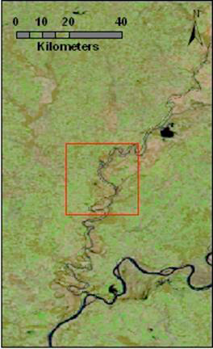
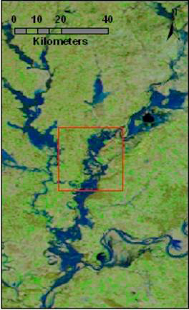
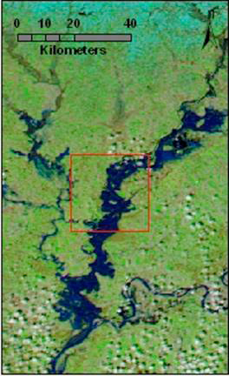
MODIS sequence of 2006 Winter Flooding
2/24/2006 C/M: 1.004 3/15/2006 C/M: 1.029 3/22/2006 C/M: 1.095
Notes:
Some measurement sites are so sensitive we can see changes even from, for example, low flow up to bank full flow. But along thousands of river measurement sites, we can most easily see the changes that occur from normal flow into various flood flow states. The C/M ratio above is the AMSR-E remote sensing data, with the two pixels included to provide the ratio. The images shown are from MODIS.
Note the dates. We captured MODIS image data on these dates, but AMSR-E provided daily updates of the discharge estimator: the C/M number. Higher ratios = higher discharge, more land flooded. The two remote sensing data systems provide synergy, and are together more accurate and powerful than using just one alone.
15

Slide 16
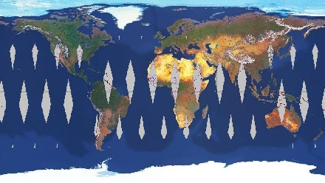
One day of data collection
(high latitudes revisited most frequently)
=> On average, global coverage 1-2 days
Notes:
AMSR-E covers the whole globe once every 2.5 days, but higher latitudes more frequently.

Slide 17
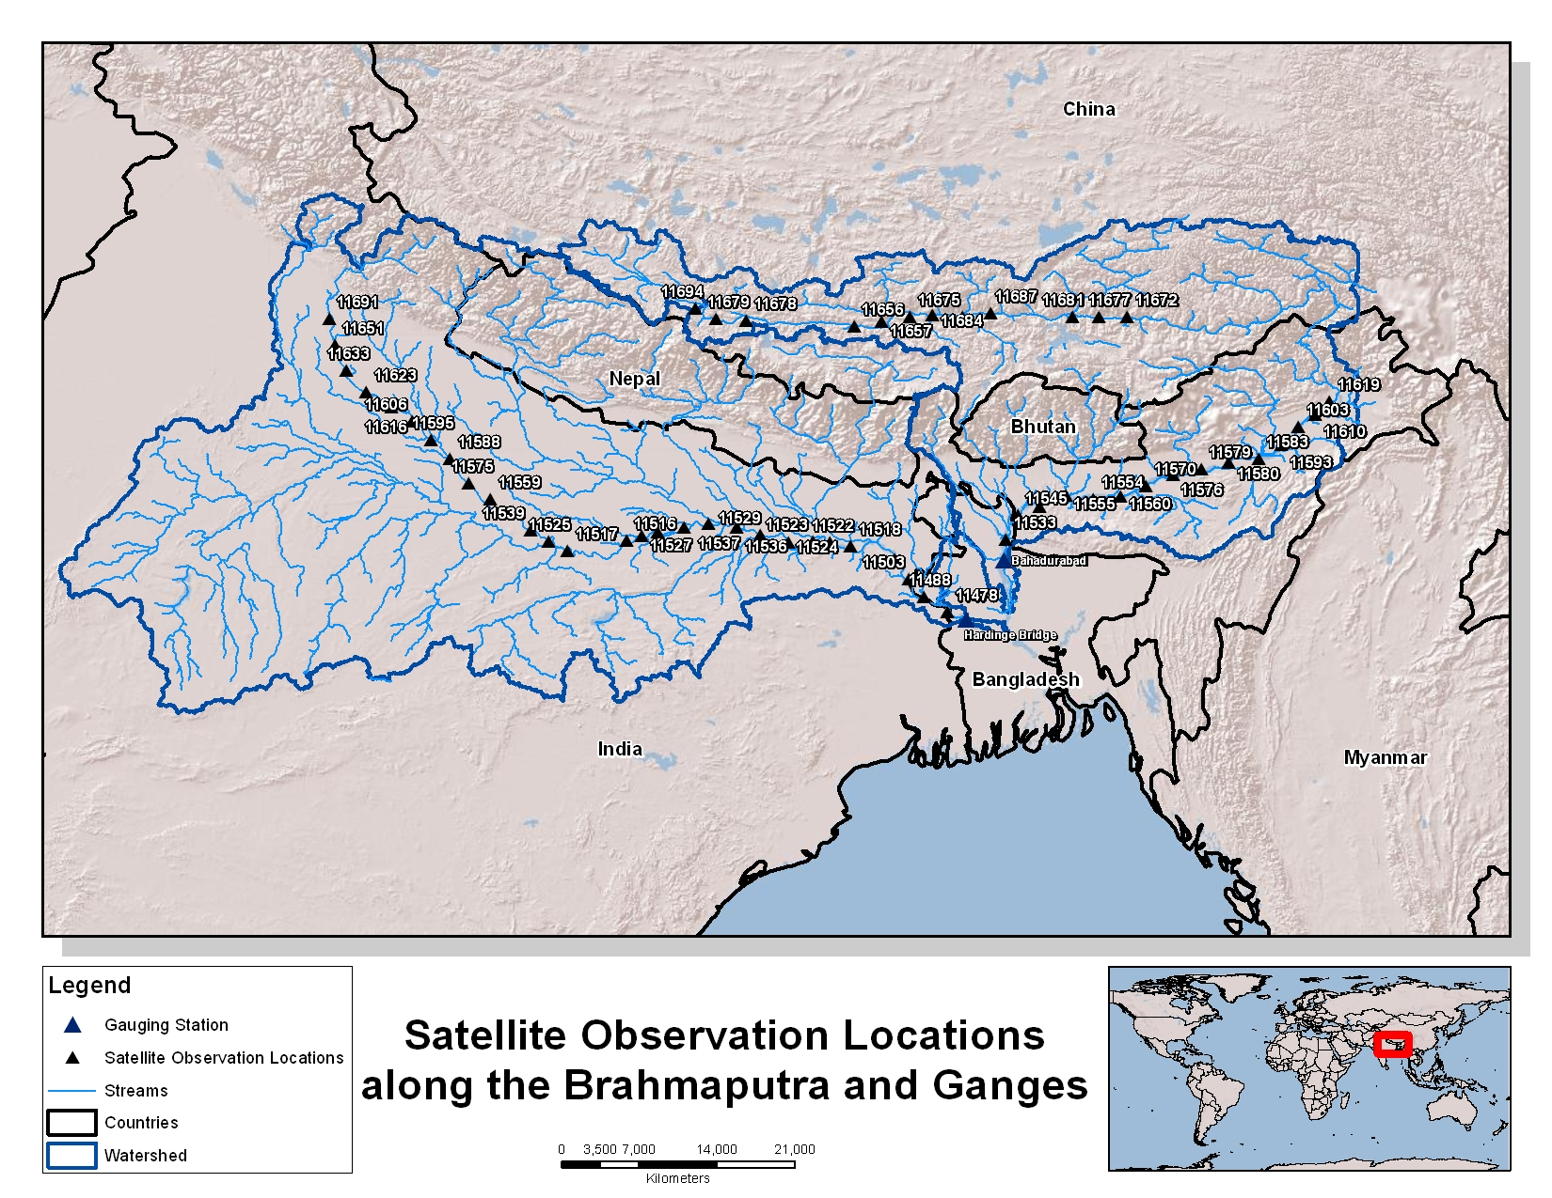
Notes:
DFO river width monitoring sites used in this consultancy, along the Ganges and Brahmaputra main stems.

Slide 18
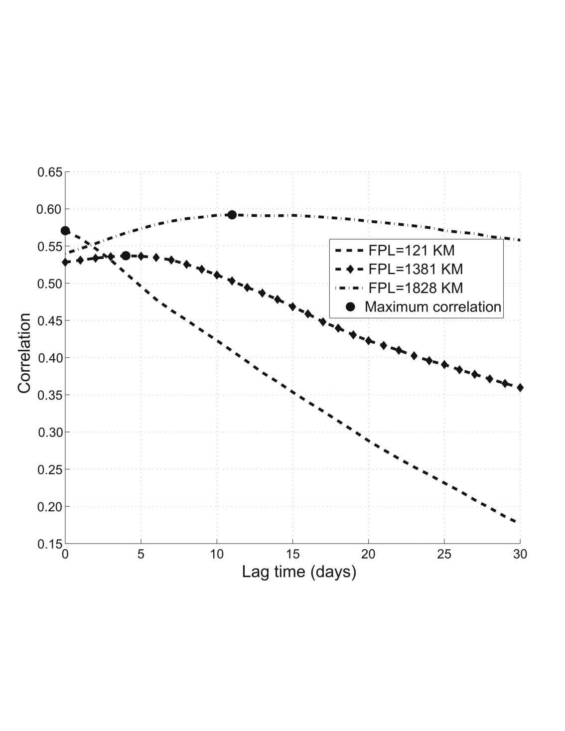
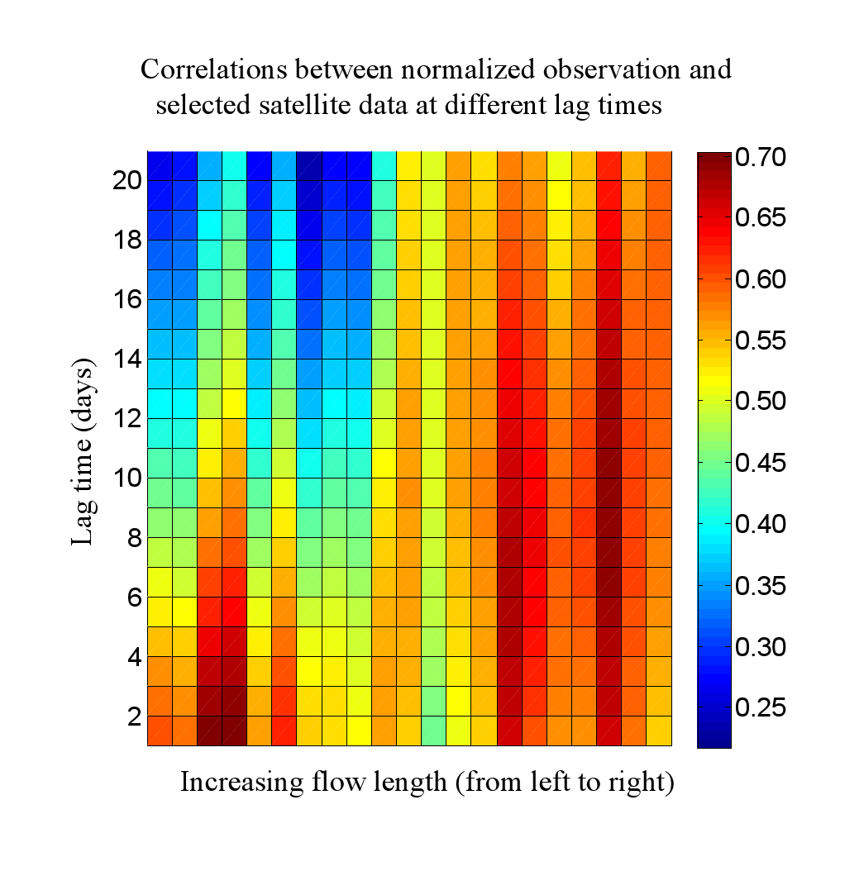
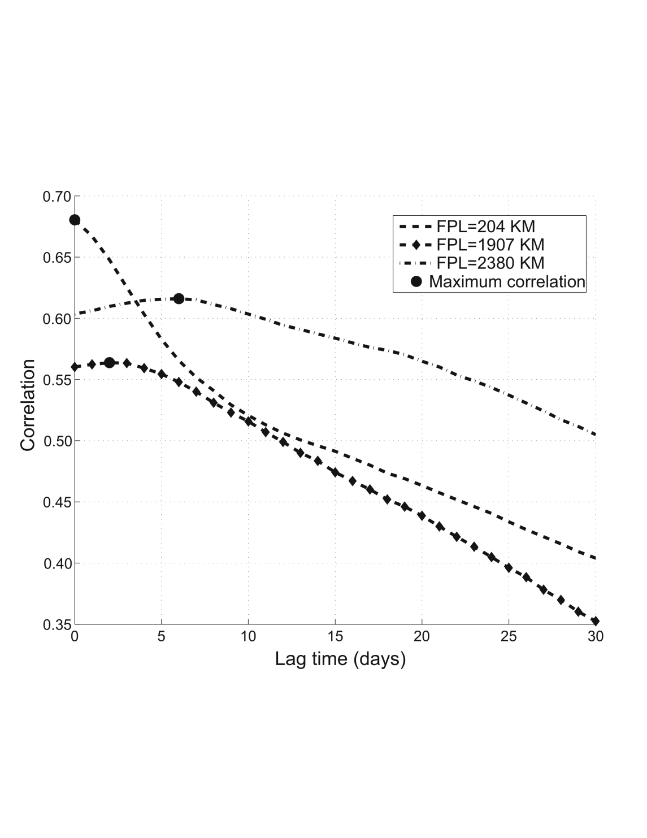
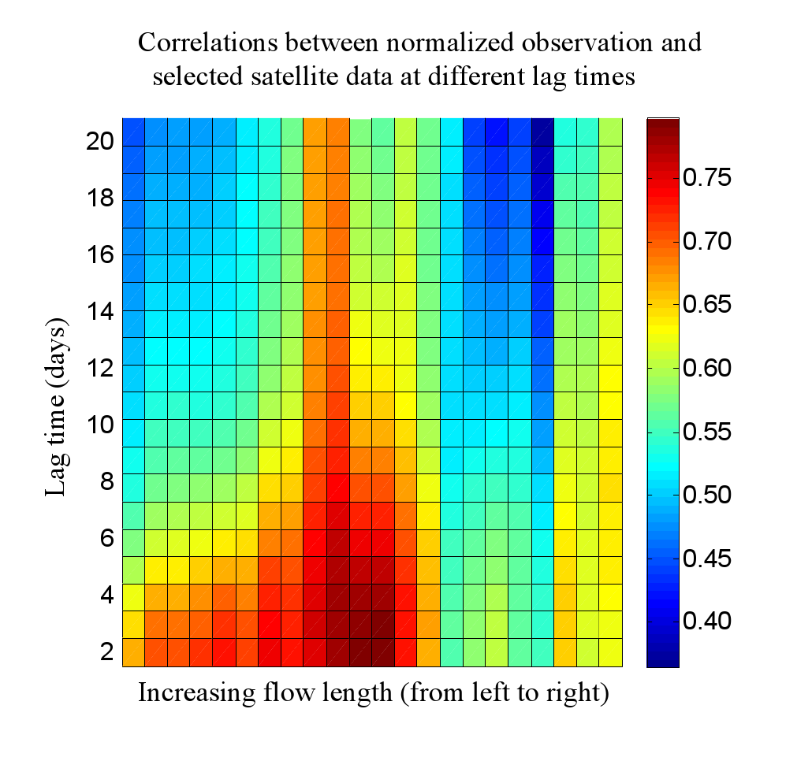
Correlation vs. lag time and distance between Gage Q & satellite signals
Ganges
Brahmaputra
Notes:
DFO monitored flood wave correlation results. Left Panels: (top) Correlation versus lag time between daily in-situ streamflow and upstream satellite flood signals, SDFs (only 3 shown here) and gauge discharge at Hardinge Bridge along the Ganges River in Bangladesh. As expected, the lag time at which peak correlation occurs (shown as a dark dot) is greater for longer flow path lengths (FPL) from the gauge at Hardinge; (bottom) same as top panel but for Bahadurabad along the Brahmaputra River. Right Panels: (top) Lagged correlation map of daily satellite-derived flow signals calculated against the discharge observation at Hardinge Bridge for Ganges River. The horizontal axis shows the satellite flood signal sites (see previous Fig) arranged in the order of increasing flow path length and the vertical axis shows lag time (days). (bottom) Same as Right-Top panel but for Brahmaputra.

Slide 19
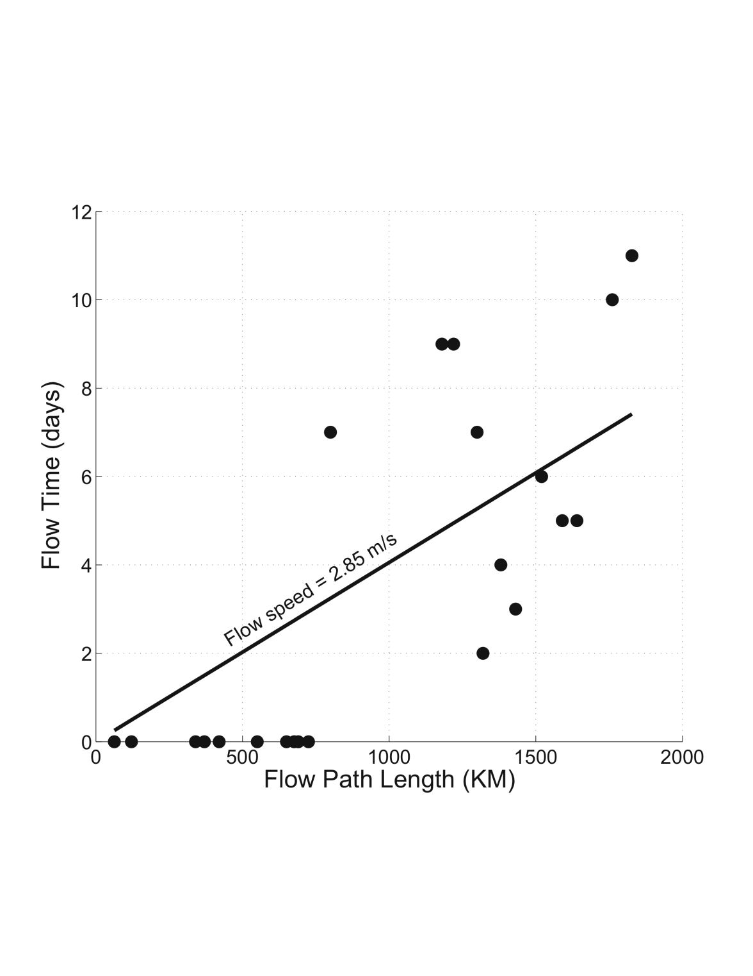
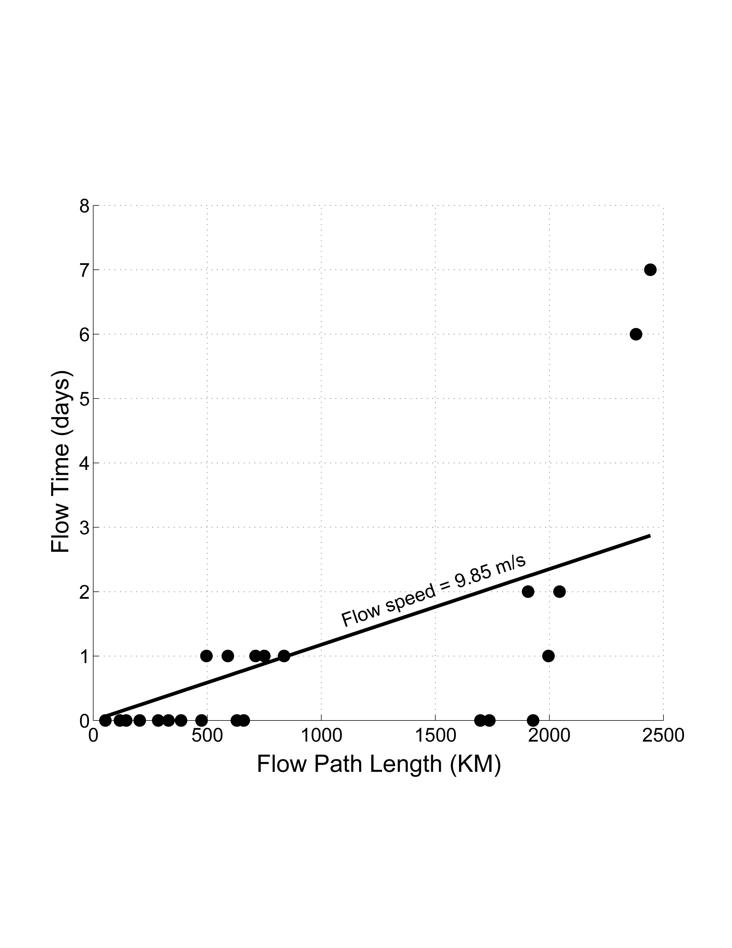
Estimating the kinematic wave celerity
Ganges
Brahmaputra
Assumptions (large): hydraulic parameters homogenous; rainfall predominantly upper-catchment; wave speed variation with depth lower-order; dynamic wave effects lower-order (confirmed through rating curve analysis – not shown), etc.
Independent analysis: Kleitz-Seddon Law for kinematic wave celerity c:
W channel top-width, Q discharge, y the river stage.
Brahmaputra at Bahadurabad: 4m/s < c < 8m/s; Ganges at Hardinge Bridge: 2m/s < c < 6m/s.
Notes:
These data were used to calculate the flood wave propagation speed down the Ganges (left) and Brahmaputra (right) rivers traveling through India. The same analysis is being carried out for the satellite alt

Slide 20

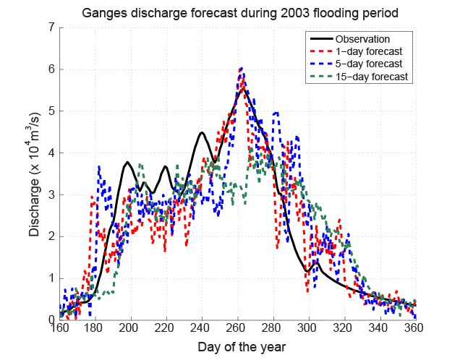
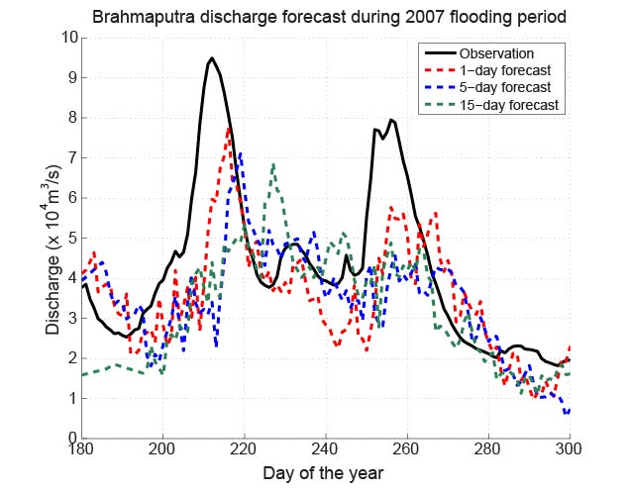
Generation of Automated Nowcasts and Forecasts
1-, 5-, 15-day Forecasts
Ganges 2003
Brahmaputra 2007

Slide 21
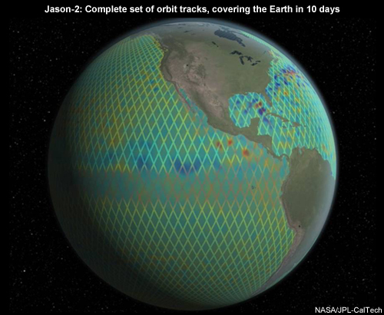
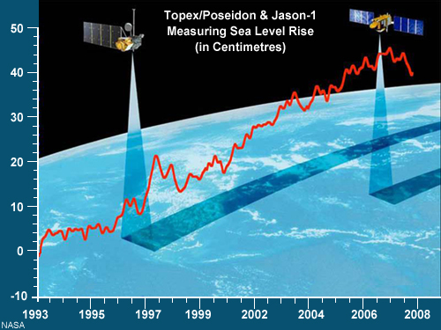
Satellite Altimetry
Traditionally used for sea level

Slide 22



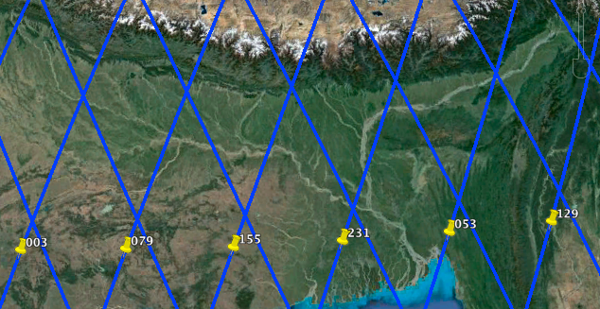
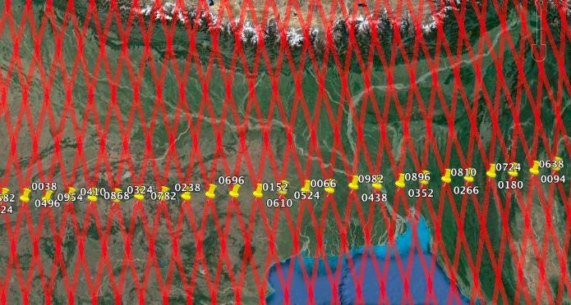
Satellite Data Sets
NASA/CNES Jason-2/OSTM mid-2008 to present day
Ku-band altimetry
10-day resolution
290m along-track sampling
Fast Delivery (24hrs delay),
Near Real Time (2day delay), and
Standard (1month delay) data available.
ISRO/CNES SARAL
early 2013 to present day
Ka-Band altimetry
35-day resolution
175m along-track sampling
Fast Delivery (24hrs delay), Near Real Time (2day delay), and Standard (1month) data available.
Notes:
Note the differences in the satellite spatial coverage and length of time to repeat between the 2 satellites. However, few test locations show SARAL data of lower quality and in need of reprocessing, so not shown here.

Slide 23
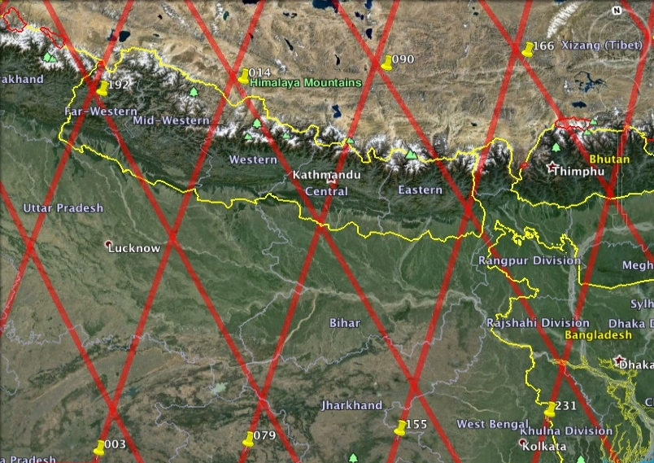
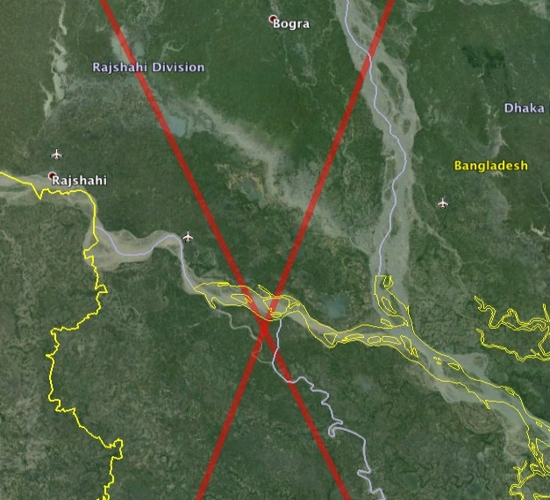
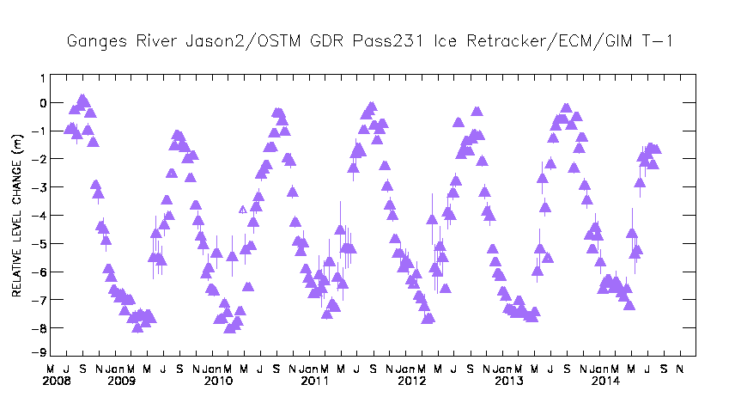
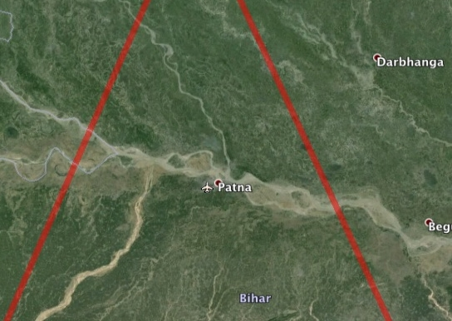
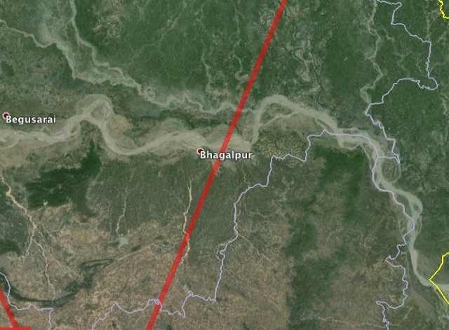
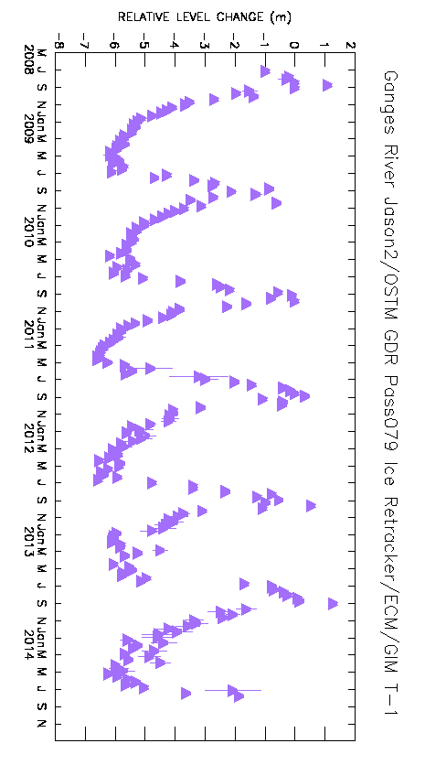
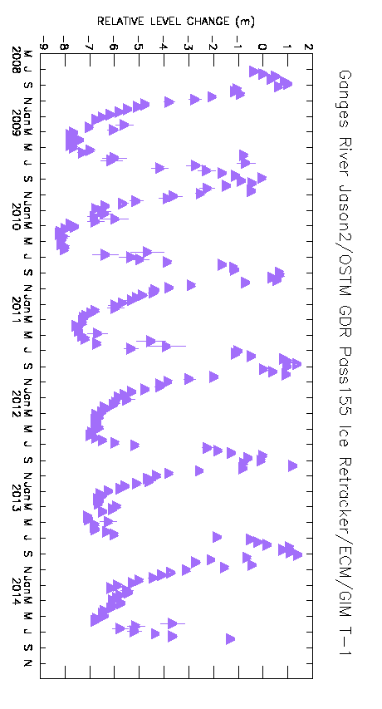
Examples of sites along the Ganges
Notes:
Lower downstream locations being shown here, with overall good results. Google Earth imagery showing the location of the satellite radar altimeter “Jason-2/OSTM” ground track crossings over the Ganges River. These crossings have a temporal resolution or repeat period of 10-days. For example, satellite passes 003, 079, and 155 etc. ascend over the river from south-west to north-east. Descending passes 192, 014, 090 etc. descend over the river from the Himalayas. Time series of water height variations can be constructed at each channel-crossing site. Preliminary results for three such sites are shown immediately below showing time series for three such sites depicting water level variations for specific ascending pass channel crossings on the Ganges River are shown immediately below. Data source: Jason-2/OSTM satellite mission (2008 to present day), GDR data.

Slide 24
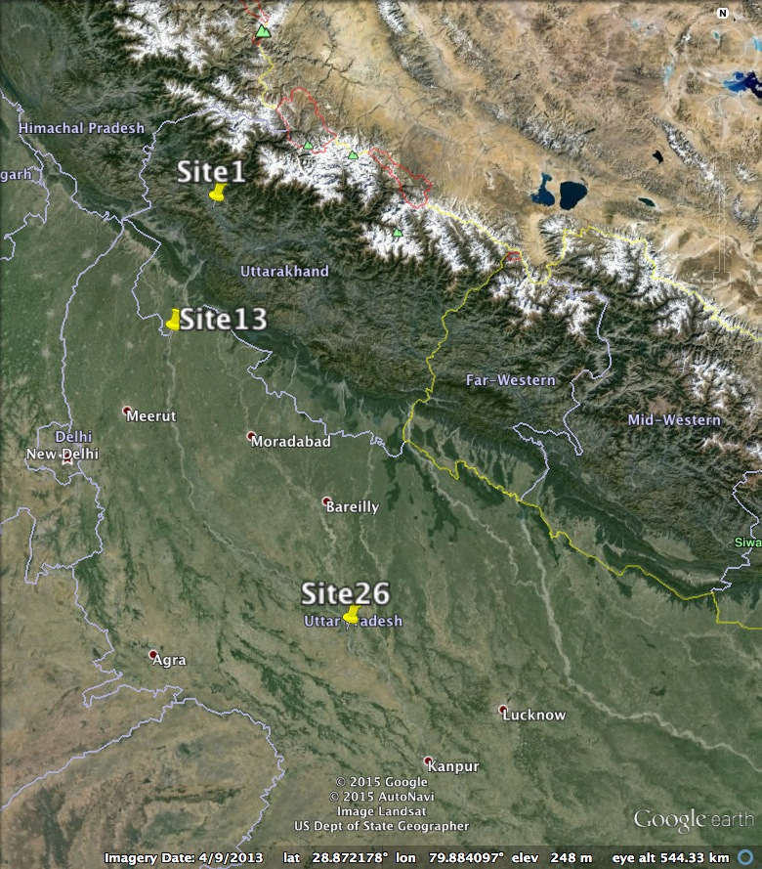
Example Results:
Locations of Test Sites: 1, 13, and 26
Notes:
But now, we move further upstream along the Ganges to test accuracies and usefulness. Results follow in next 3 slides.

Slide 25
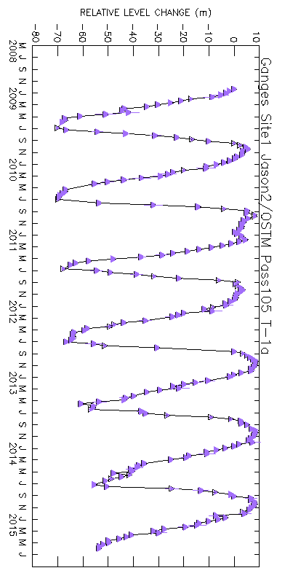
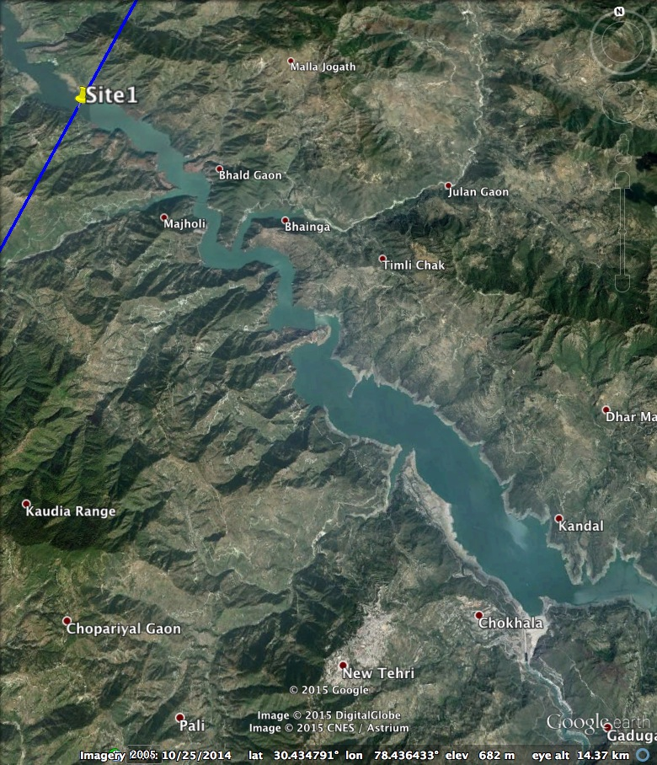
Example Results
NASA/CNES Jason-2/OSTM (Standard GDR-D 10day)
Site 1: Tehri Reservoir (30.520lat, 78.367lon)
52km² water body, 700m along-track crossing extent

Slide 26
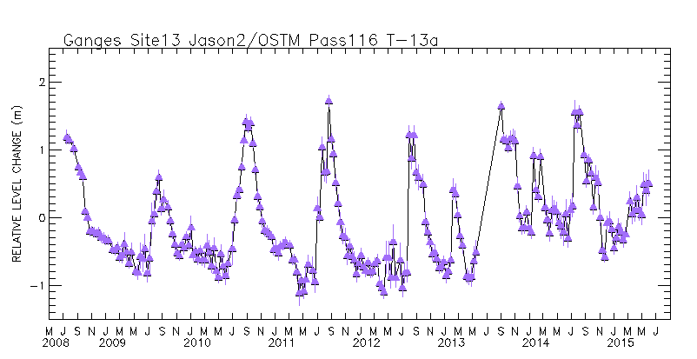
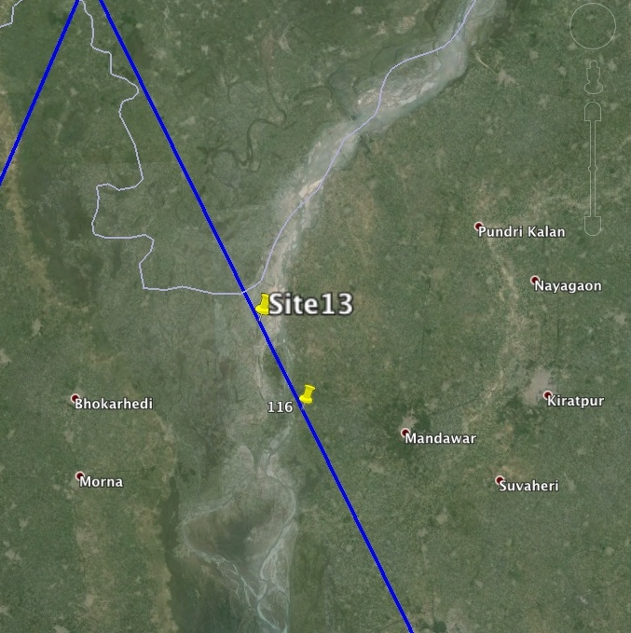
Example Results
NASA/CNES Jason-2/OSTM (Standard GDR-D 10day)
(Right-top) Relative Elevation Variation (metres)
(Right-bottom) Radar Backscatter Coefficient Variation (dB)
Site 13 :
(29.534lat, 78.048lon)
6,500m along-track crossing extent. Main channel ~150m wide.
Notes:
Note that 2 different types of data can be used to monitor heights – both shown here with their correspondence in signal seen.

Slide 27
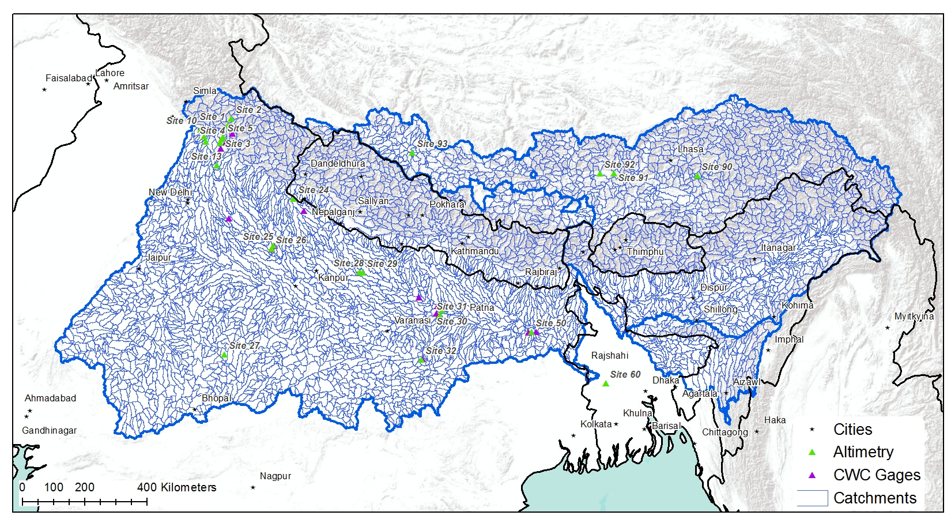

Slide 28
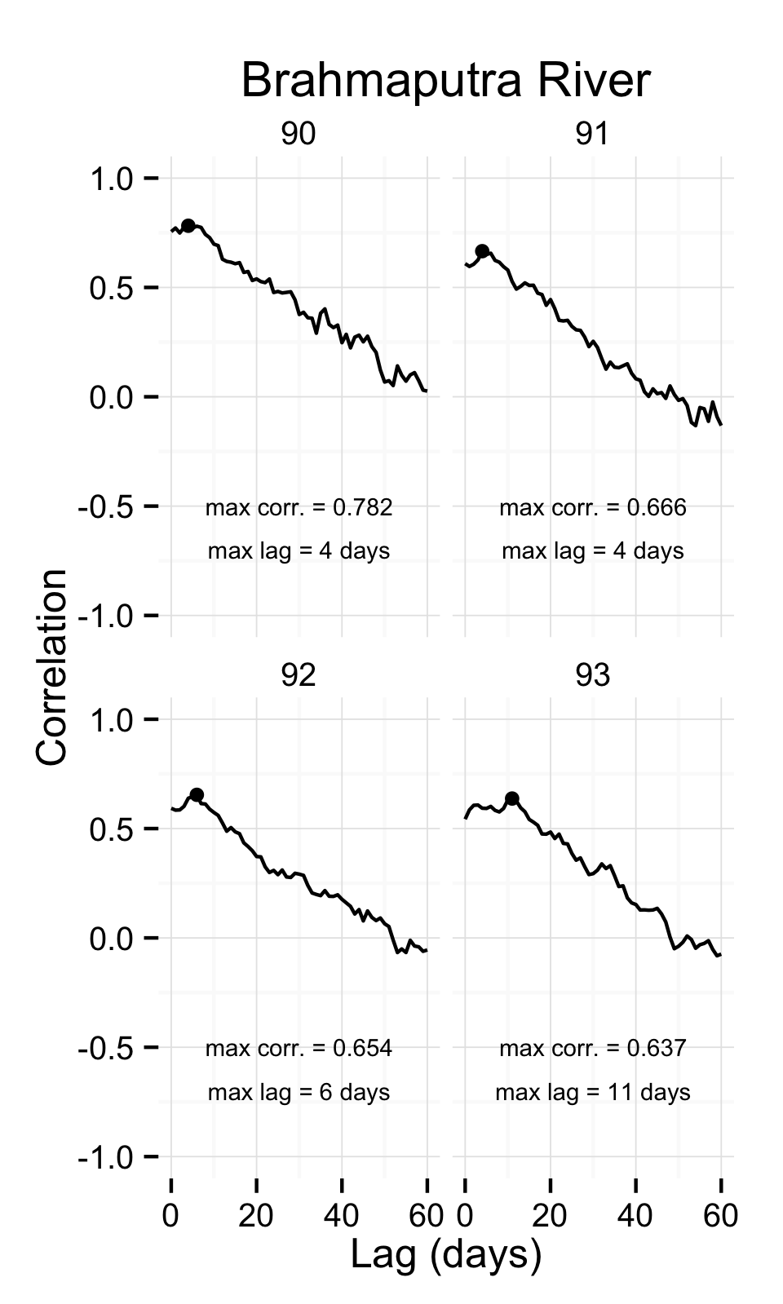
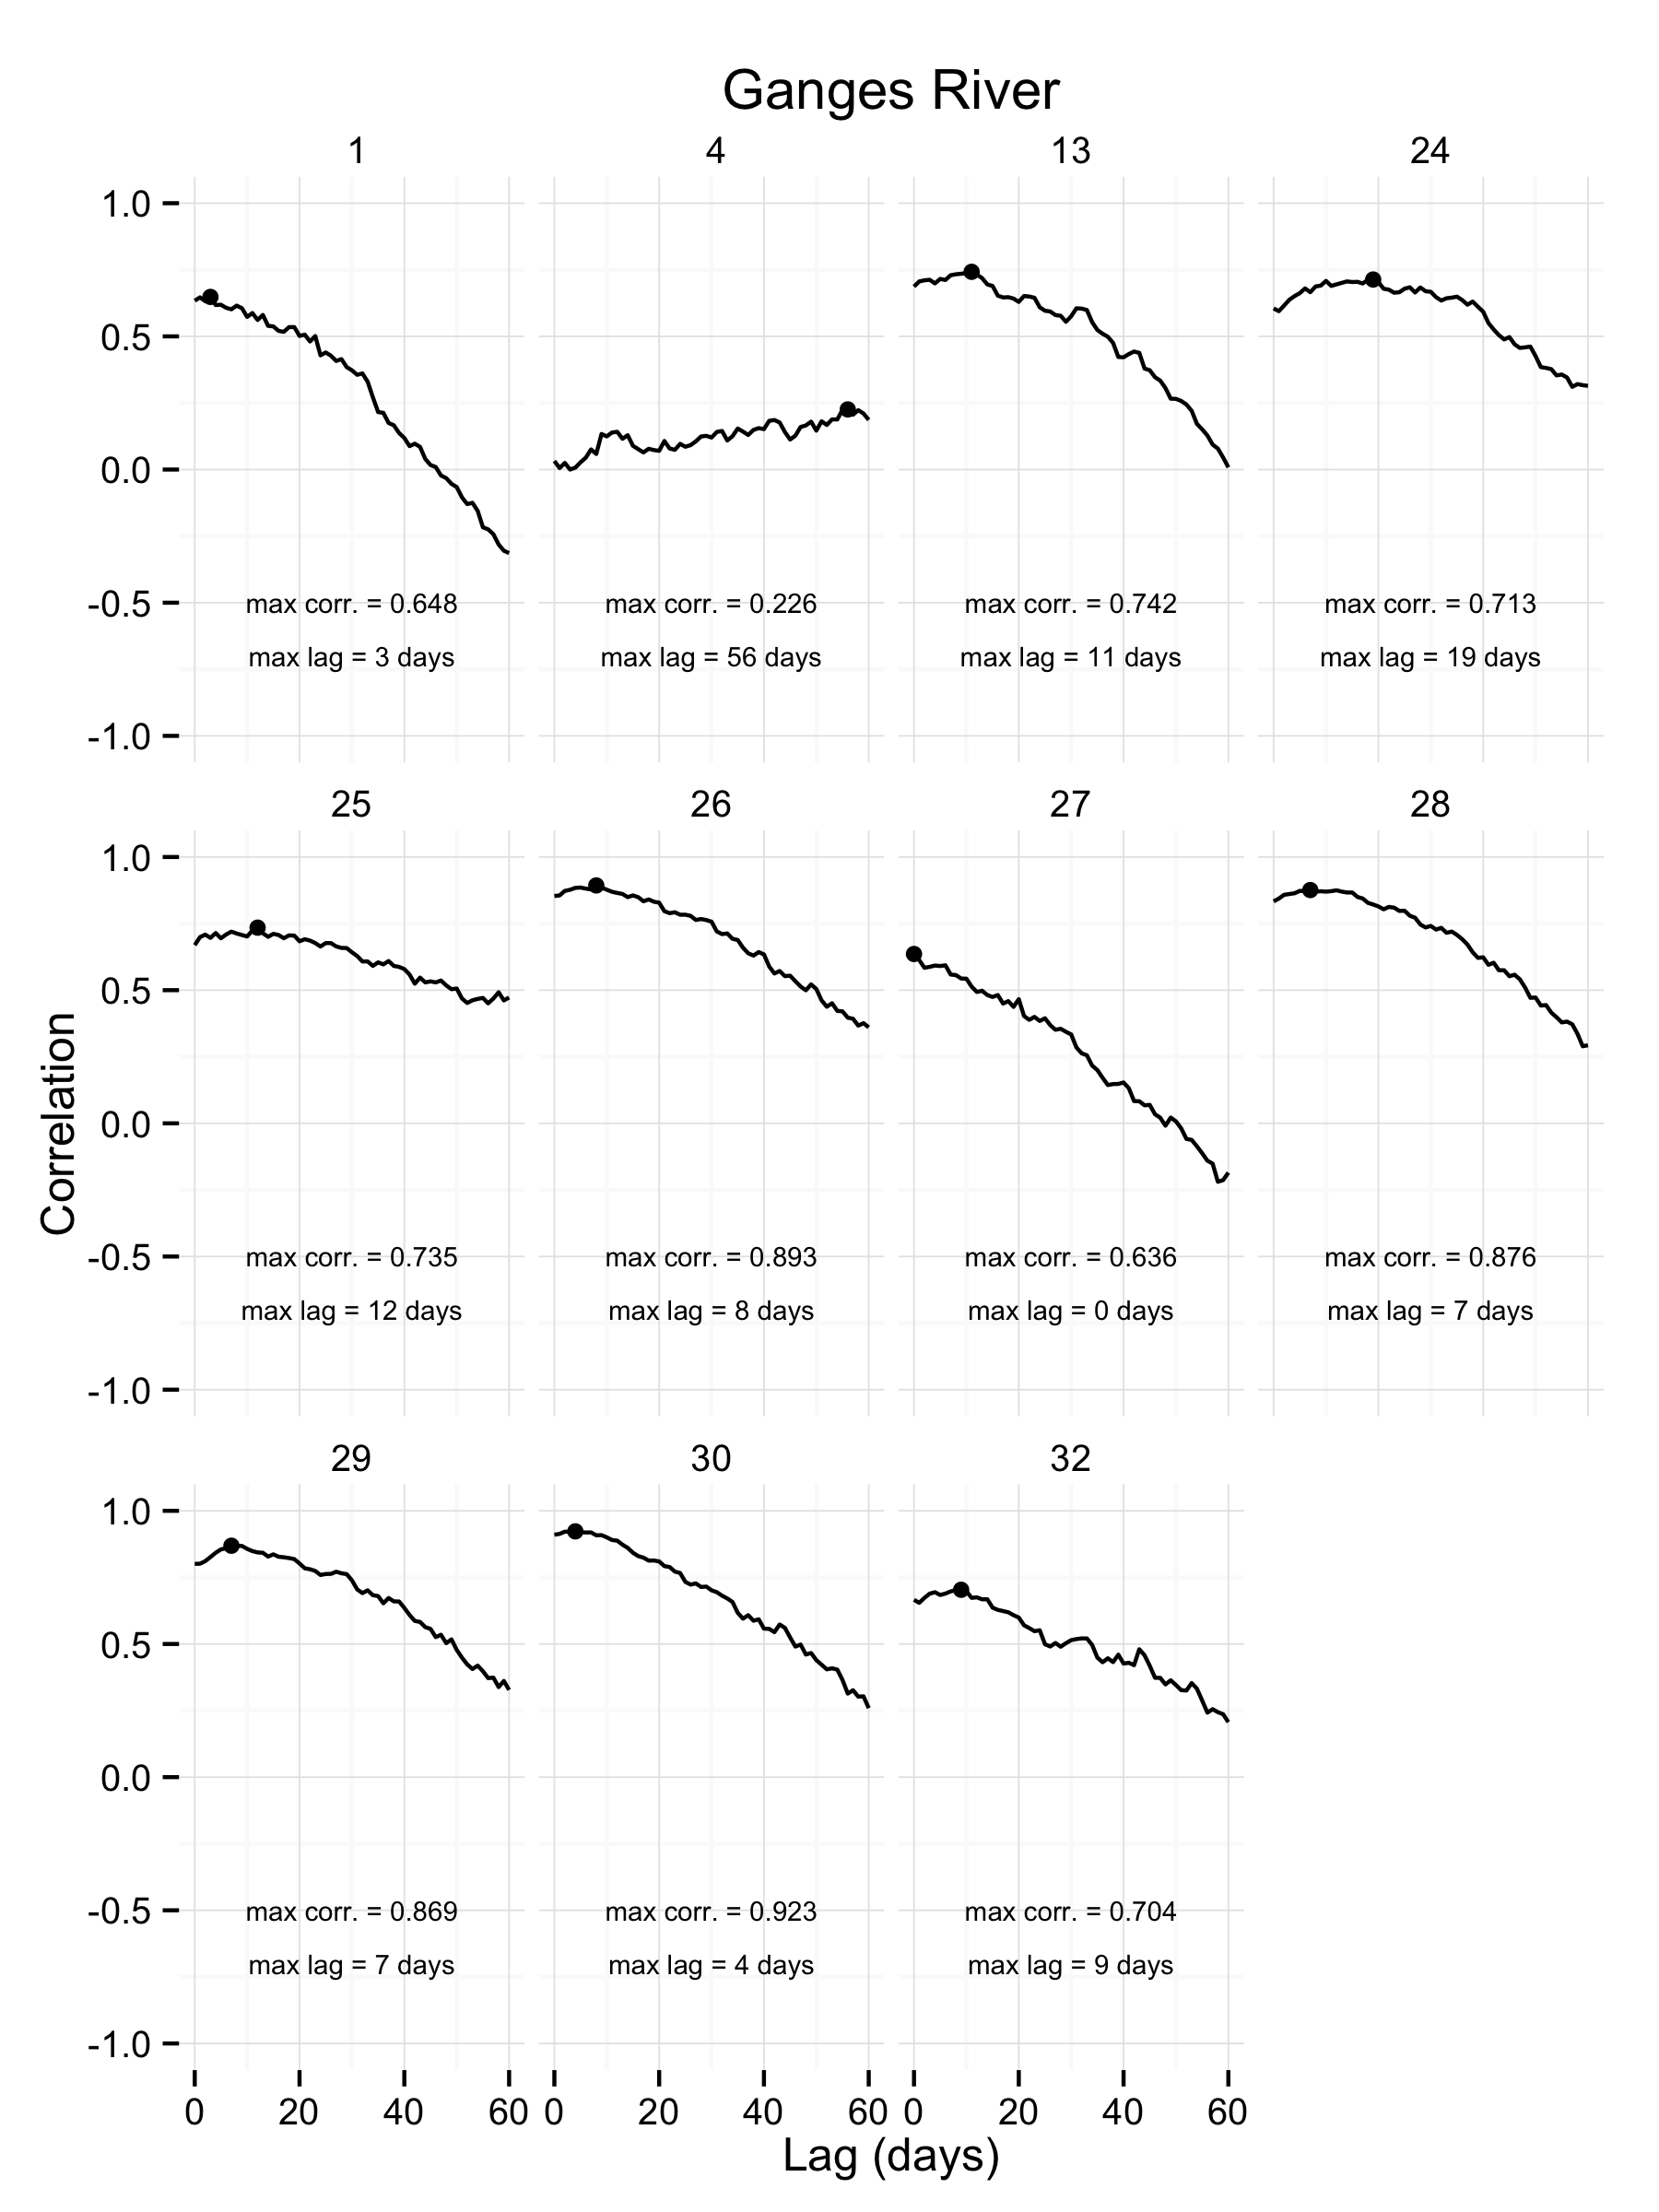

Slide 29
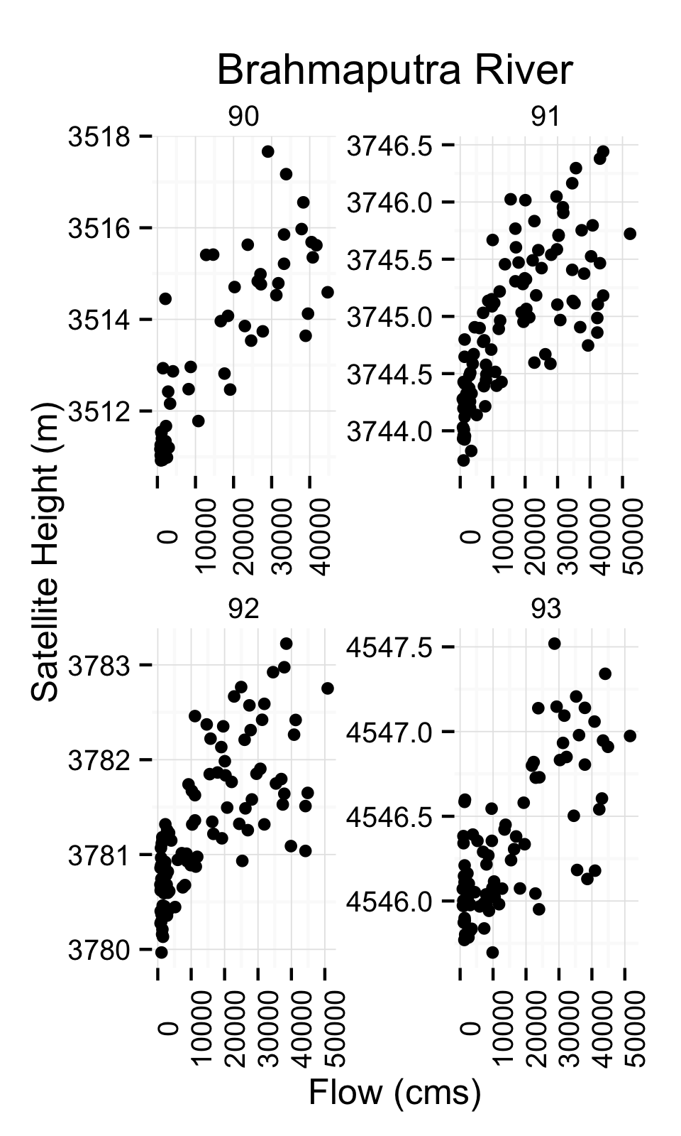
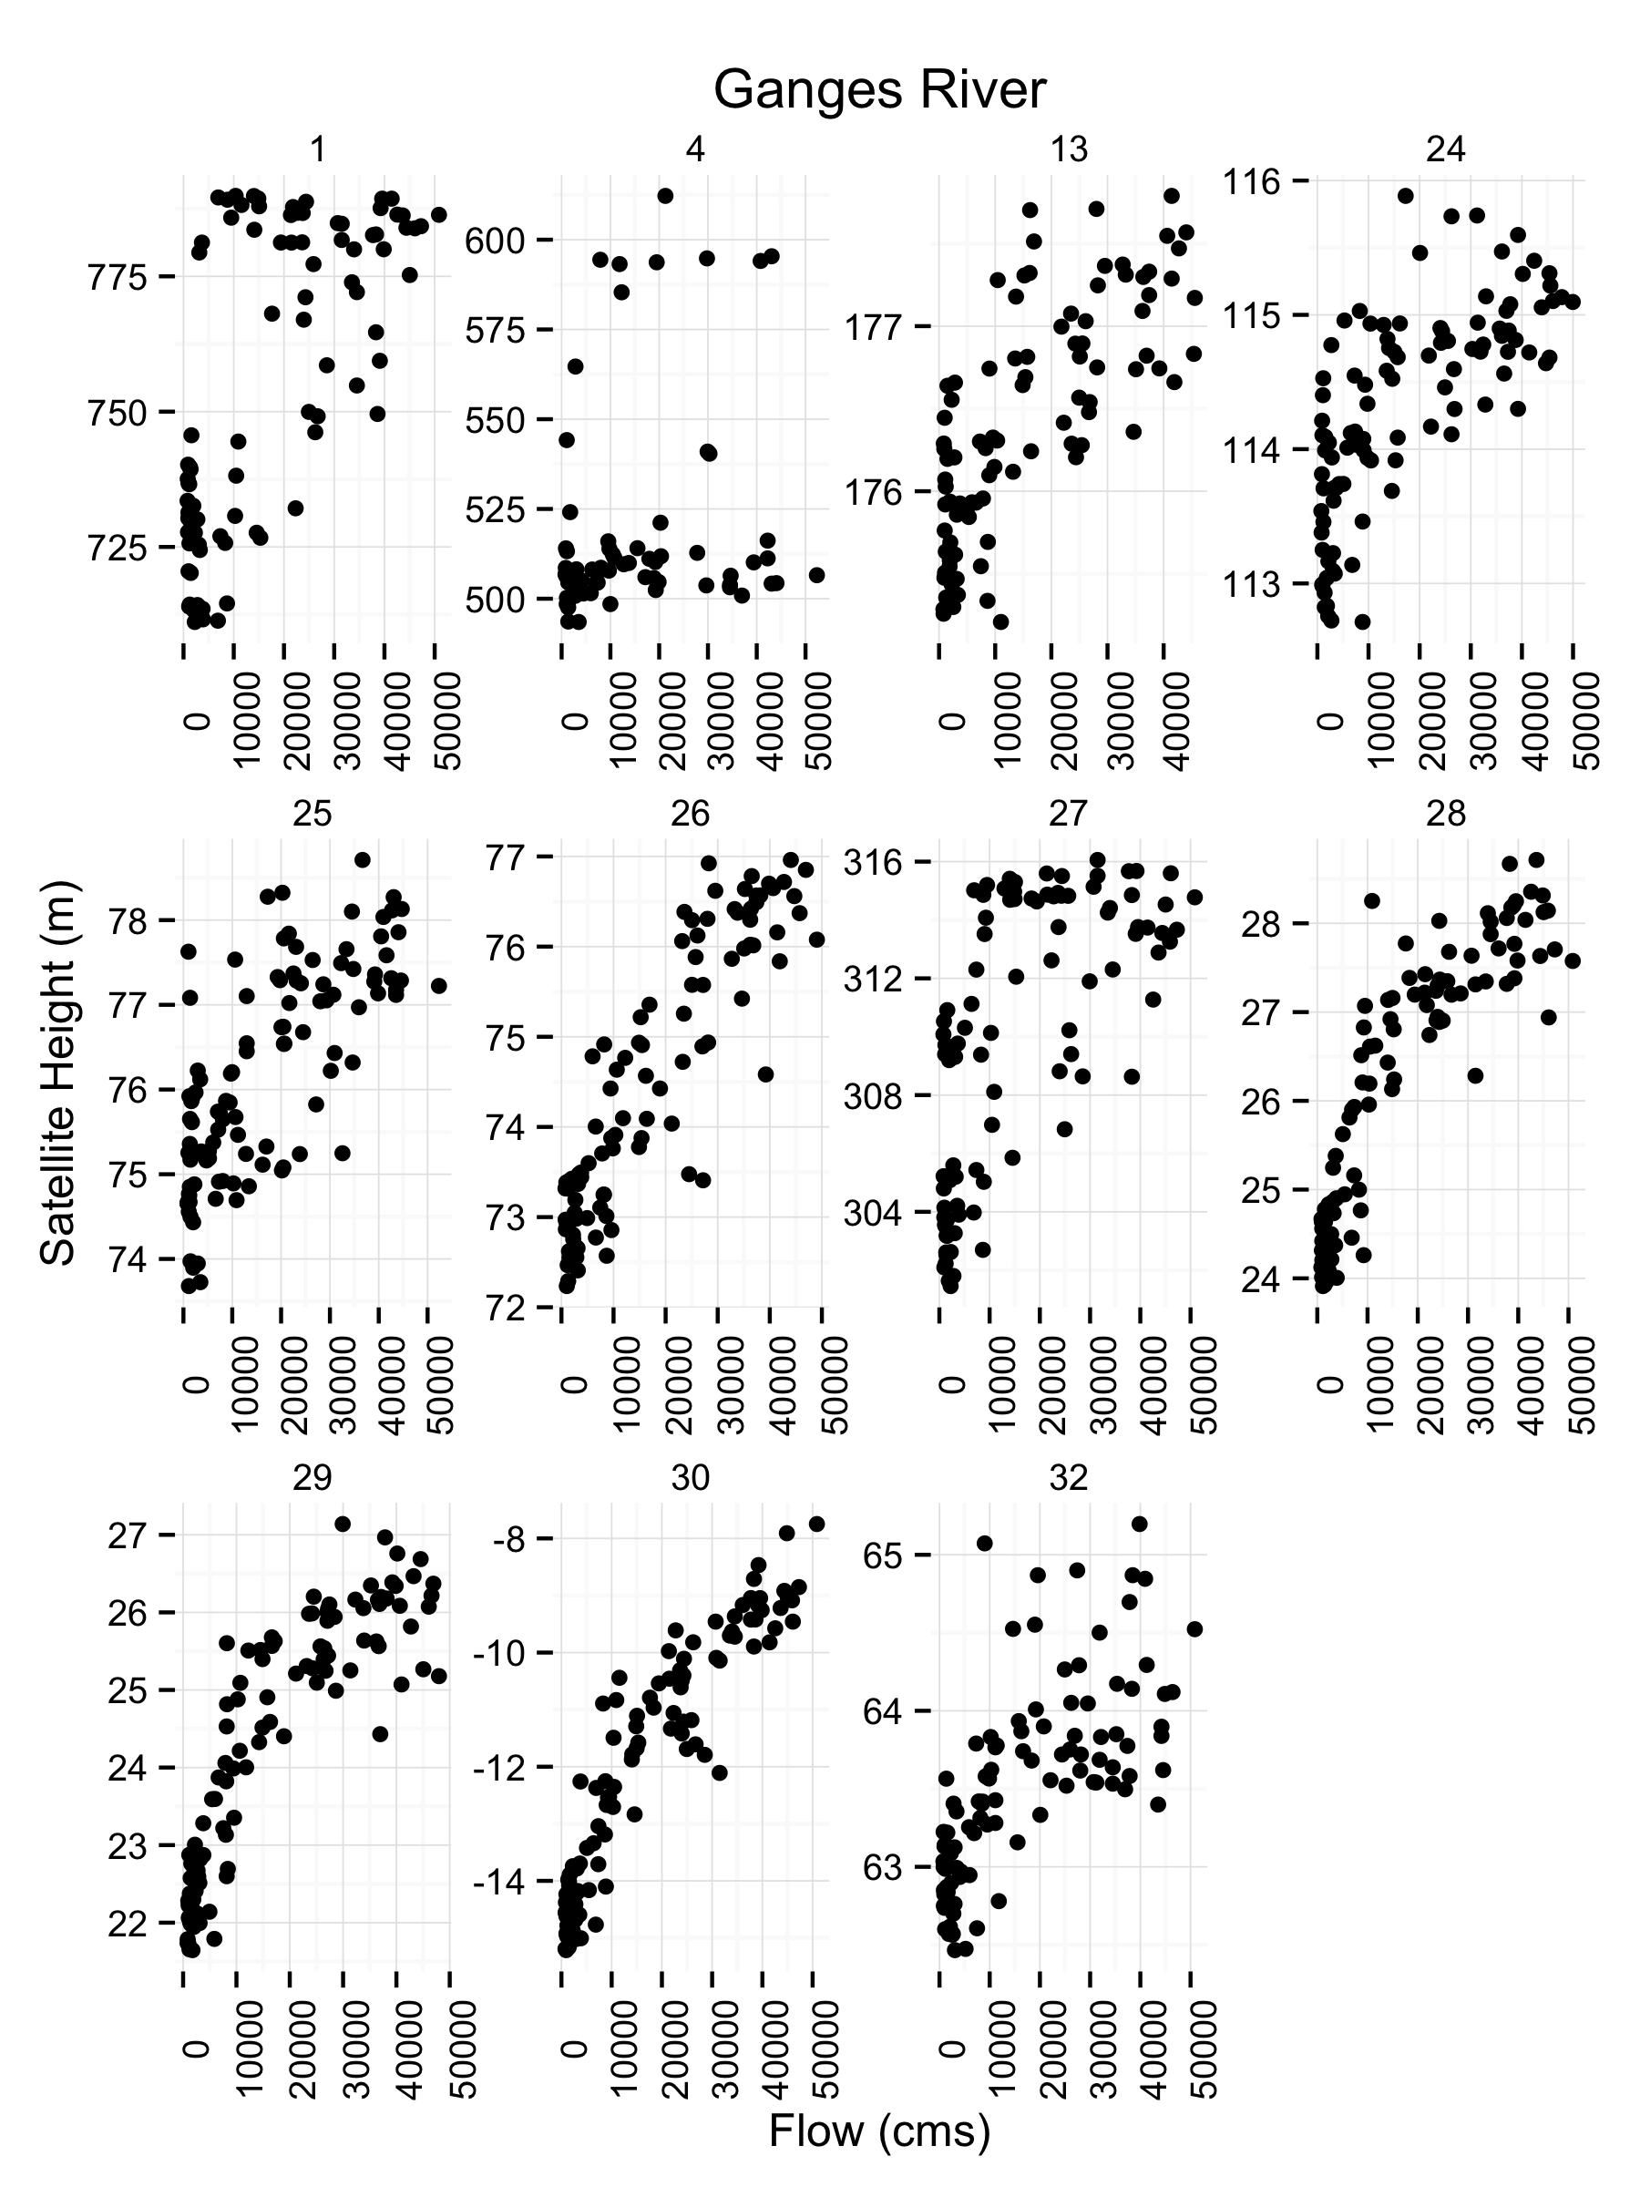

Slide 30
Generation of Automated Nowcasts and Forecasts
1-, 5-, 15-day Forecasts
… but now based on a combination of river width and altimetry measurement
Ganges 2003
Brahmaputra 2007

Slide 31
Sources of Predictability
Model solutions to the streamflow forecasting problem…
Historical Data
Forecasts
SNOW-17 / SAC
Historical Simulation
Precipitation
Soil moisture
River flow
Past
Future
Run hydrologic model up to the start of the forecast period to estimate basin initial conditions;
Run hydrologic model into the future, using an ensemble of local-scale weather and climate forecasts.
Notes:
Now we consider what happens when we used forecasts of rainfall, instead of just observed -- requires running the hydrologic model into the future using ensemble (i.e. probabilistic) weather forecast data.

Slide 32
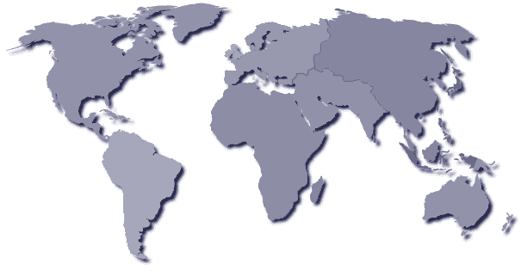
Unique Datasets/Software Created
Thorpex-Tigge
UKMO
CMC
ECMWF
CMA
NCAR
MeteoFrance
NCEP
JMA
NCDC
IDD/LDM
HTTP
FTP
Archive Centre
Current Data Provider
CPTEC
Notes:
Using the Thorpex-Tigge data for this project. Green dots show forecasting centers which we are using their forecasts for.

Slide 33
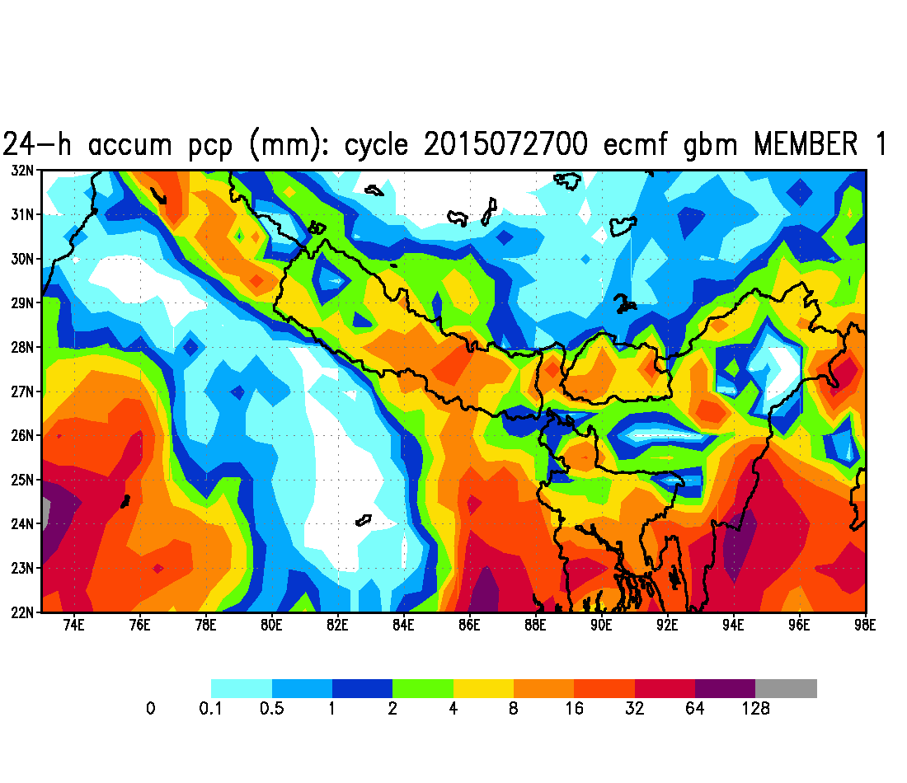

Notes:
Movie: ECMWF 24-hr forecasted daily rainfall over the Ganges and Brahmaputra basins showing the variability in all 50 ensemble members

Slide 34
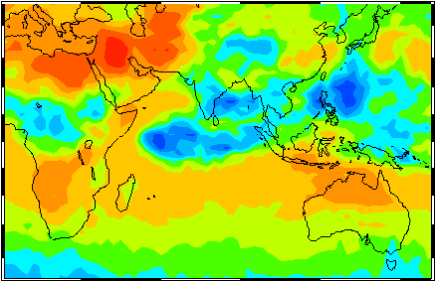
Operational Flood Forecasting for Bangladesh:
Tom Hopson, RAL-NCAR
Peter Webster, Georgia Tech
A. R. Subbiah and R. Selvaraju, Asian Disaster Preparedness Centre
Climate Forecast Applications for Bangladesh (CFAB):
USAID/CARE/ECMWF/NASA/NOAA
Bangladesh Stakeholders: Bangladesh Meteorological Department, Flood Forecasting and Warning Center, Bangladesh Water Development Board, Department of Agriculture Extension, Disaster Management Bureau, Institute of Water Modeling, Center for Environmental and Geographic Information Services, CARE-Bangladesh
Notes:
34
All these data can be integrated under the general framework of the CFAB: Project began in 1999, became fully operational in 2003, with a program to actively disseminate the forecasts down to the household began this year. To our knowledge, first time USAID has funded a university-based research group to produce an operational humanitarian assistance program
Affiliations:
Hopson – NCAR/RAL
Webster -- Georgia Institute of Technology, Principal Investigator
Subbiah and Selvaraju -- Asian Disaster Preparedness Centre (non-profit based in Bangkok)
Special acknowledgments:
NASA-GSFC for using their satellite-based TRMM product (Tropical Rainfall Measuring Mission)
NOAA-CPC (Climate Prediction Center) CMORPH (CPC Morph) http://www.cpc.ncep.noaa.gov/products/janowiak/cmorph_description.html
Both the NASA-TRMM and NOAA-CMORPH produces global precipitation analyses at very high spatial and temporal resolution. Both techniques use precipitation estimates that have been derived from low orbiter satellite microwave observations and geostationary IR satellite data. CMORPH differs from TRMM in that CMORPH uses the microwave satellite-derived rainrates exclusively, and uses the geostationary satellite IR data to propagate the “cloud”-features/rain-rates.
Funding Agencies: USAID-Dhaka and CARE-Bangladesh; ECMWF (Europ. Center for Medium-Range Weather Forecasts) provides their full 51-member weather variable forecasting fields free-of-charge (!!) to support this humanitarian effort.
I also acknowledge NASA-GSFC (Goddard Space Flight Center) Laboratory for Atmospheres, and NOAA-CPC (Climate Prediction Center) since we’ve been using their satellite-based TRMM (GSFC) and CMORPH (NOAA-CPC) precipitation estimates and rain gauge interpolated fields operationally since 2004 (more on this later, including showing results). (For TRMM, the primary individuals behind this are George Huffman and Robert Adler.) (For CMORPH, the primary individuals are Bob Joyce, John Janowiak, and Phil Arkin and Pinging Xie; for the rain gauge [also NOAA-CPC], Pingping Xie is the primary individual.)
Stakeholders w/in Bangladesh -- no need to list, just acknowledge active Bangladesh institutional involvement/stackholding.

Slide 36
Daily Automated Operational Flood Forecasting Sequence
Notes:
36
Schematic of the 1-10day discharge forecasting sequence for the Brahmaputra and Ganges rivers (which was fully-automated in 2004, to the huge relief of the first author!).
Red boxes show inputs to the hydrologic forecast model. From right to left, these include:
updated model calibrations (from an automated background calibration process);
daily discharge observations of the Ganges and Brahmaputra at the border crossings provided by the FFWC (note that their consistent availability has allowed us to implement an error forecasting and correction scheme discussed later -- orange box below);
TRMM and CMORPH satellite-derived precipitation estimates provided near-real-time by the GSFC Laboratory for Atmospheres and NOAA Climate Prediction Center, respectively, along with daily-updated interpolated rain-gauge fields (also NOAA-CPC). These precipitation sources were incorporated into the operational forecasts in 2004, but as such represented a new technical challenge: how to incorporate different sources of precipitation inputs that may each have their own biases relative to each other. To deal with this, that same year we developed what we call a “quantile-to-quantile” mapping approach which we will not discuss here.
The most-left red box represents the ECMWF ensemble weather forecasts, which once they are received each day, triggers the forecasting sequence and all initial conditions (soil moisture, in-stream flows) are locked in.
Orange box to account for all sources of uncertainty in the discharge forecast.
These inputs feed into a separate catchment-lumped model (blue box), and a semi-distributed model (green box) similar in structure to the NWS SAC-SMA model (Sacramento Soil Moisture Accounting model). Note that all steps shown below the horizontal dashed line are done independently for each day and forecast lead-time separately. Both of these hydrologic models are then blended together (again, done independently for each day and forecast lead-time) to form a multi-model forecast, shown in yellow. We won’t say much here about this multi-model process, except that operational forecasts using 51-member ECMWF forecasts began in 2003 using only the catchment-lumped model only (blue box) since far simpler to implement (thanks to Keith Beven for constructive advice on implementing this model in these early stages); in 2004 we brought on-line the semi-distributed model, and at this point it was natural to retain both forecast models under a multi-model framework.
A separate algorithm is then used to both forecast and statistically account for all sources of error, shown in the orange box. This algorithm was also brought on line in 2004, and has been “tweeked” over the last couple of years -- this algorithm and some of these improvements will be briefly discussed in this talk.
Note: ovals represent topics covered in remaining part of this talk -- last oval represents final operationally-derivered forecasts, which we will show results from (focusing on 2004).
Aside: "lumped" model means that the modeling of the discharge process (i.e. going from rainfall inputs to discharge output) is being treated as a single point, without regards to where the rainfall falls within the catchments (so the rainfall inputs into the lumped model are being spatially averaged over the whole catchment first, before going into the model) -- this is the simplest model once can use for discharge forecasting. "Distrbuted" means you're now accounting for where the rainfall/runoff occurs within the catchment itself, and the local conditions of the watershed at those locations (i.e. how saturated the soil moisture is, etc.).
Further comments: each day after the ECMWF forecasts are received, it takes approximately 2hrs for forecasts for both the Ganges and Brahmaputra to be generated (again, all automatically done). The ECMWF forecasts are updated daily (automatically sent through FTP to Georgia Tech from ECMWF -- ECMWF is under the European Union’s jurisdiction, but based in Reading, UK), the TRMM estimates are updated every 3hrs approximately, and the CMORPH and CPC-raingauge are updated daily.
Note that the forecasts are independently done for both the Ganges and Brahmaputra rivers close to the border crossing point of each river as it enters into Bangladesh from India. Severe flooding within Bangladesh can occur in years when both rivers crest at the same time, especially affecting the regions near and downstream of their junction (see slide 2), and this in-turn can affect the flow rates of these rivers as they enter into the country if the backwater effects from their junction point propogate far enough upstream. Currently this is not being accounted for, and is one weakness of our current forecast scheme. However, I am in the process of implementing a more advanced routing scheme to account for this effect.

Slide 37
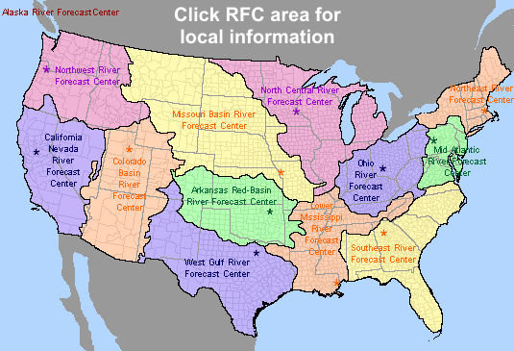

River Forecast Centers
… Integrated under a new National Water Center
Notes:
Also utilizing a new system developed at NCAR and currently also being employed across the whole of the US as the US’s primary hydrologic forecasting tool …

Slide 38
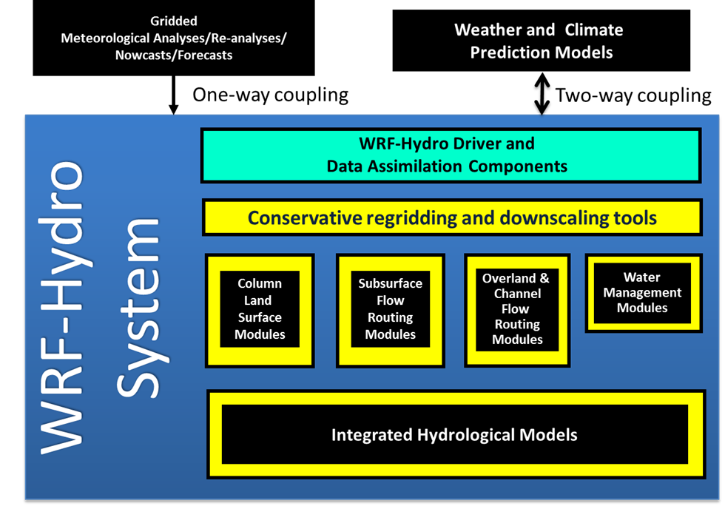
WRF-Hydro System
Slide from David Gochis
… developed at NCAR in collaboration with US and international universities
Notes:
Developed at NCAR

Slide 39
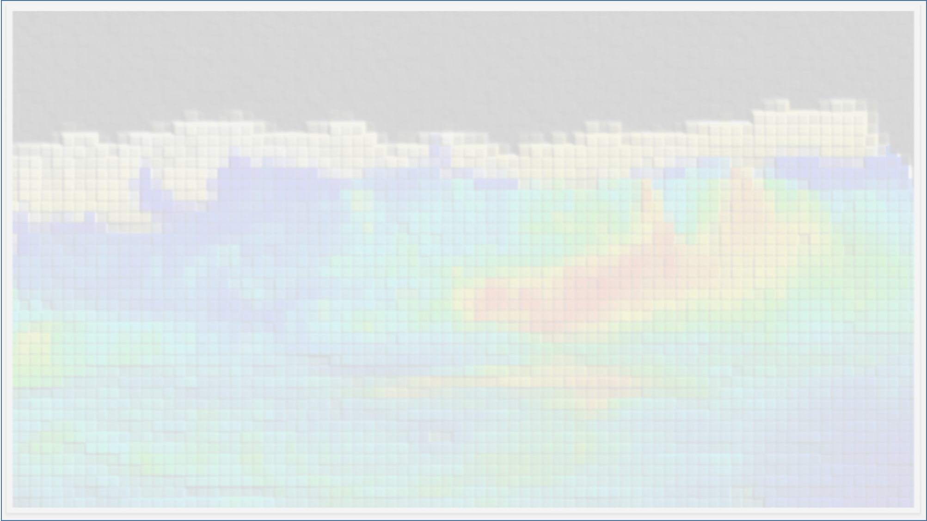
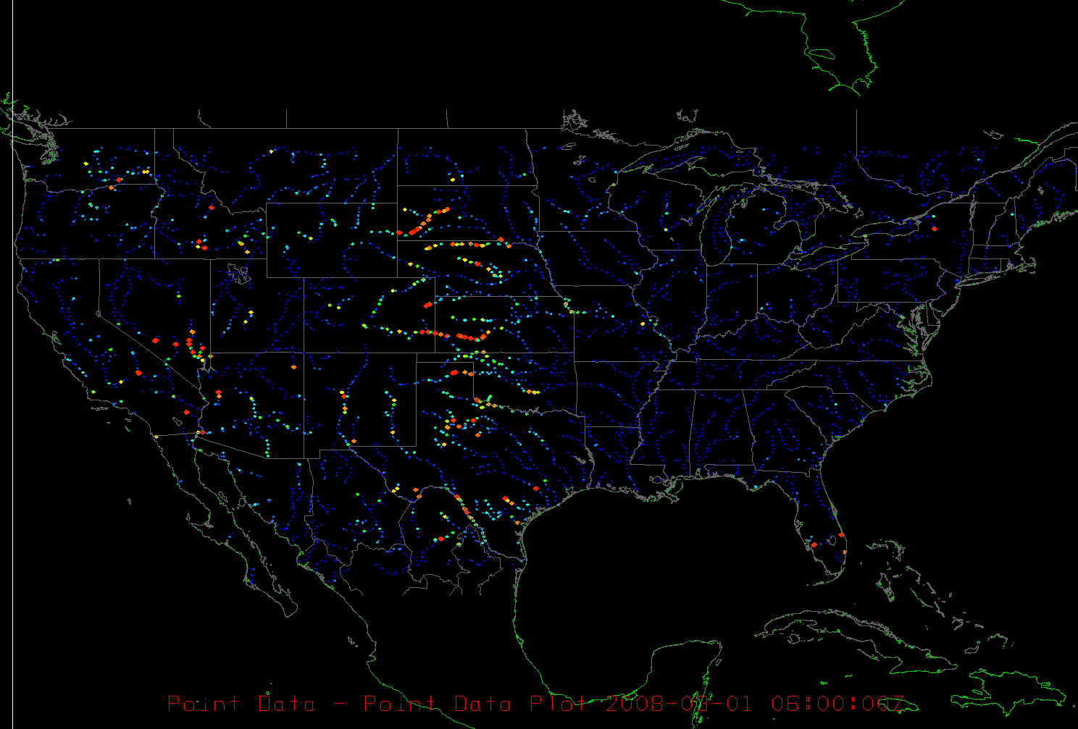
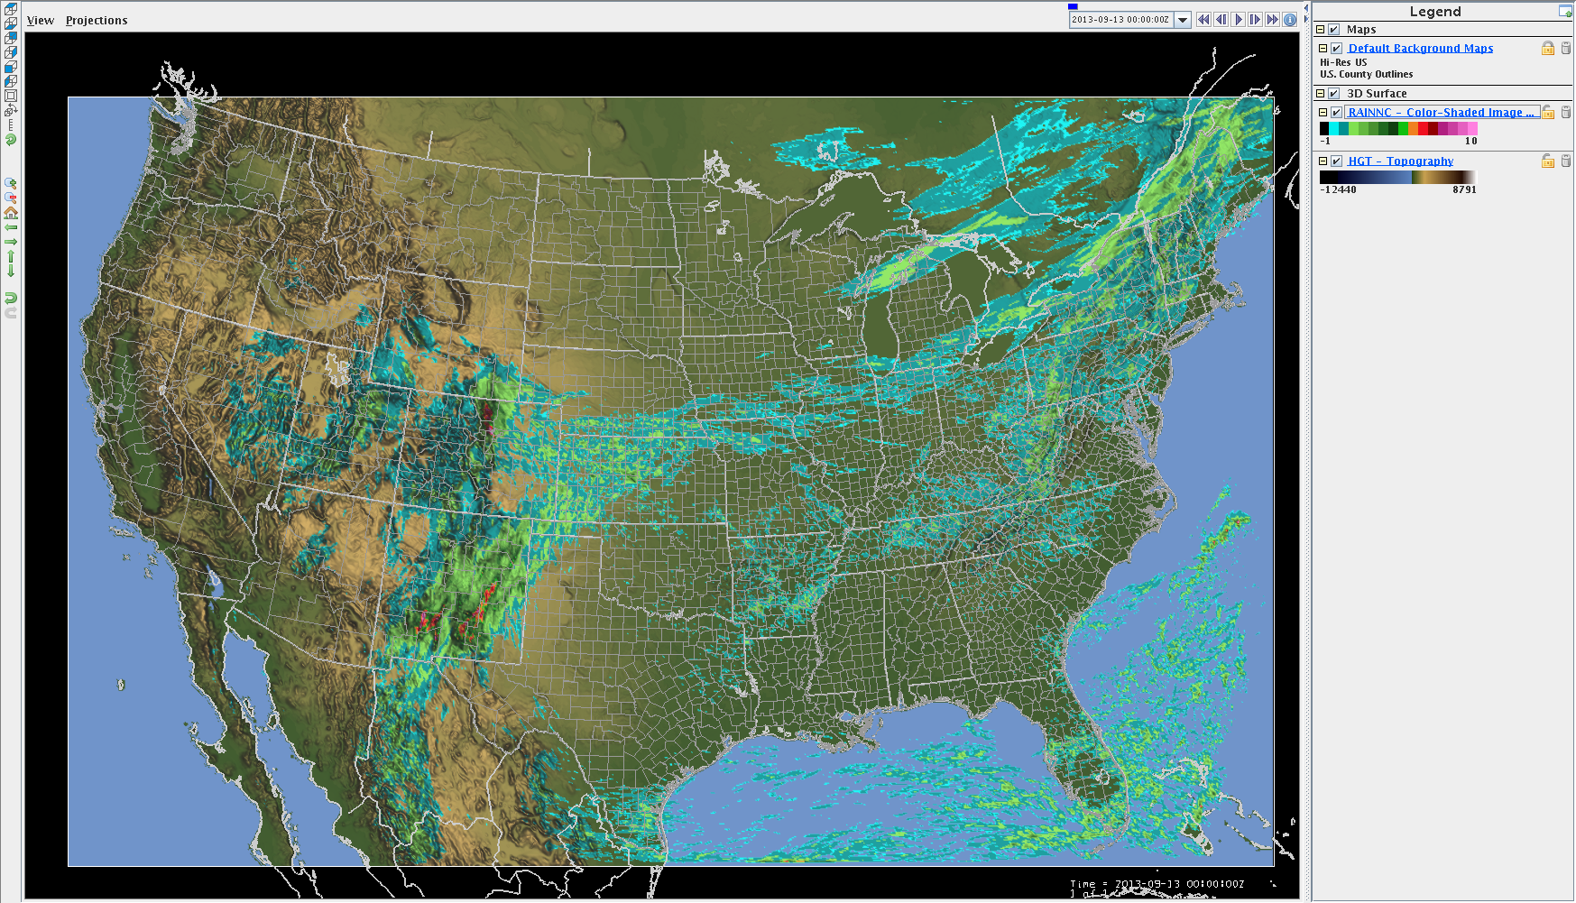


National-scale domain applications: 2km/250m
48-hr MPE Accum. Rainfall
Sept. 11-13, 2013
Top-layer soil moisture 250m
Channel ‘inflows’ 250m
Slide from David Gochis
Notes:
Movie of the US nation-wide implementation of the WRF-Hydro system

Slide 40
Recent Applications of CFAB and WRF-Hydro Systems:
Slide from David Gochis

Slide 41


CFAB: 2004 Brahmaputra Ensemble Forecasts and
Danger Level Probabilities
Brahmaputra Discharge
Forecast Ensembles
Above-Critical-Level
Cumulative Probability
7 day
8 day
3 day
4 day
7 day
8 day
5 day
9 day
10 day
9 day
10 day
Notes:
41
With the corrections made, the observed discharge falls within the ensemble bundle: good!
From the final suite of weighted error-corrected ensemble members, you can derive confidence bands directly
Red lines: 95% confidence – good for decision-makers to determine risk thresholds.
These figures show the actual CFAB 7 to 10 day discharge forecasts for the Brahmaputra basin for 2004. We have randomly selected 51 new ensemble members from the combined model error/precipitation forecast uncertainty PDF discussed in the previous slide. Uncertainly bounds are shown on the right (95% red, 50% yellow). The horizontal dash line represents a “critical river flood stage” level. Notice that in July of that year the Brahmaputra twice went over this level (leading to the deaths of approximately 500 people in this basin -- recall the 3rd slide of this talk). We were able to forecast this event with some skill out 10 days in advance. At that time, the CFAB forecasts were not fully integrated within the forecasting warning procedures of the country. As truly tragic as this was, the fact that we were able to forecast these two events established our credibility in providing a useful warning capability for this country.

Slide 42


CFAB: 2007 Brahmaputra Ensemble Forecasts and
Danger Level Probabilities
7-10 day Ensemble Forecasts
7-10 day Danger Levels
7 day
8 day
7 day
8 day
9 day
10 day
9 day
10 day
Notes:
42
2005 (not shown) and 2006 (shown here) discharges for both Brahmaputra (left) and Ganges were well below severe flooding levels, as forecasted.

Slide 43

WRF-Hydro Fully-coupled Hydrometeorological Prediction
Event Description: Colorado Floods of 2013
  Maximum rain totals of > 18 inches (450mm in 5 days), est. 0.1% rainfall event
  Multitude of single day, week, month, annual rainfall totals recorded
  Flooding less than 1.0% probability widespread across several counties
  Several towns and communities completely evacuated
  Transportation corridors destroyed
  Water/wastewater infrastructure destroyed
  Measurement infrastructure destroyed
  Pervasive groundwater flooding
Slide from David Gochis

Slide 44



WRF-Hydro Applications:
Regional Flood Forecasting - Sep. 2013 Front Range
MPE – driven WRF-Hydro, Sep 11-13, 2013
Slide from David Gochis
Notes:
Movie of the multi-day severe flooding event in Colorado, USA in September 9-15 2013 – left panel shows the accumulated rainfall and the underlying river flow response during this severe flooding period

Slide 45

Interactive Data Display
    All observed data from the database are available by time
    Points may be color-coded and clicked for additional detail
    Additional data overlays added:
      Precip observations and forecasts
      NCAR flood model forecasts
      Weather model data (gridded)
      High-resolution basemaps
    Time series plots
    Decision support:
      Forecast simulation
      Flood warning
      Reporting interface

Slide 47

Monitoring Extremes in Subcatchment Rainfall
Interactive Data Display

Slide 48

Monitoring Extremes in Subcatchment Rainfall (cont)
Interactive Data Display

Slide 49

Transforming discharge into inundation maps
DFO Archived History of Inundation
Figure 6. The DFO record of flooding in this portion of the Ganges Basin is shown as light blue (2000 to 20111), light red was flooding in the 10 days prior to map update date, and red was current flooding. The numbers indicate River Watch discharge measurement sites. This is a small subscene of the complete Surface Water Record display for this region.
Approach:
Predicted model flow compared with historic model flow
Corresponding hindcast dates used to extract imagery
Notes:
Where high resolution DEM’s are not available, forecasted river flows can be paired with historic imagery of the Dartmouth Flood Observatory to show projected regions of inundation. The DFO record of flooding in this portion of the Ganges Basin is shown as light blue (2000 to 2011), light red was flooding in the 10 days prior to map update date, and red was current flooding. The numbers indicate River Watch discharge measurement sites. This is a small subscene of the complete Surface Water Record display for this region.

Slide 50


Slide 51
Summary
Indirect satellite measurements of river discharge (changes in river width or height) provide new potential for flood warnings due to travel time lags in downstream water flow
New era in flood forecasting where reliable, freely- and quickly-available remote sensing, global ensemble weather prediction products, and hydrologic modeling systems are available for flood forecasting
We are developing independent forecasting systems based on each of these technologies, that can be optimally combined. However …

Slide 52

Summary (cont)
“Power” will likely come from integrating these products under a common “data assimilation” and forecasting framework where weaknesses counter-balanced and strengths capitalized upon
Data Assimilation: The Basics
Improve knowledge of Initial conditions
Assimilate observations at time t
Model “relocated” to new position

Slide 53




Recent Floods: Bihar, Odisha, UP
Assam June …
… and Aug-Sept 2015
Uttarakhand June 2013

Slide 54

“I have a very strong feeling that science exists to serve human welfare. It’s wonderful to have the opportunity given us by society to do basic research, but in return, we have a very important moral responsibility to apply that research to benefiting humanity.” Dr. Walter Orr Roberts (NCAR founder)
Notes:
“I have a very strong feeling that science exists to serve human welfare. It’s wonderful to have the opportunity given us by society to do basic research, but in return, we have a very important moral responsibility to apply that research to benefiting humanity.”
Walter Orr Roberts

Slide 55
For more information, contact
hopson@ucar.edu

